Slide 1
Which Materials Conduct Heat the Best?
Samuel DuPont 2009
HEAT

Slide 2

First, a review…
Samuel DuPont 2009
STARS!

Slide 3
Matter
Samuel DuPont 2009
Where is Matter found?
What are two things all matter must have?
What are the three types (phases) of water?
Which phases take the shape of its container?
What do we do to a solid to turn it into a liquid?

Slide 4
Magnets
Samuel DuPont 2009
All magnets have two _______.
One is _______ and one is _________.
If we push two “like” poles together, what happens?
What about opposite poles?
Are magnets attracted to all metals?
Magnets are attracted to materials with _______ in them

Slide 5
Forms of Energy
Samuel DuPont 2009
List the 5 basic forms of energy.
Sound is the ______ of air which moves in a ________.
Lower pitch makes the waves get _______
Higher pitch makes the waves get _______
Heat travels from ______ to _______
We measure heat with a __________

Slide 6
New Vocabulary!
Samuel DuPont 2009
Conduct
  The transfer of energy through matter
Similar Words
  Conduction
  Conductivity

Slide 7
Do all materials conduct heat the same?
Samuel DuPont 2009
Are some faster than others?
  Can you think of any which are fast?

Slide 8
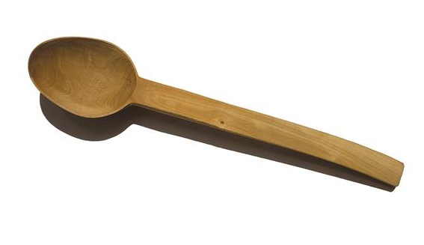
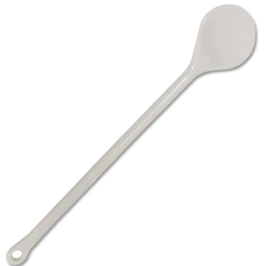
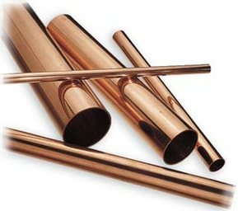
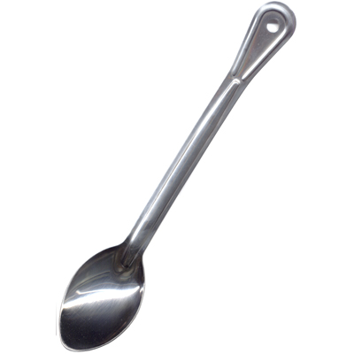
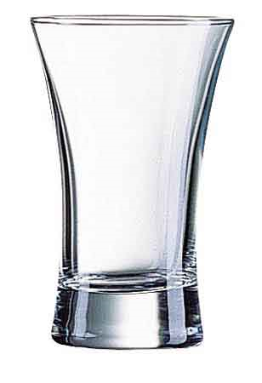
Which Material do you think?
Samuel DuPont 2009
Which one will move heat faster?

Slide 9
Lets Experiment!
Samuel DuPont 2009

