Slide 1
Forms of Energy
Samuel DuPont 2009

Slide 2
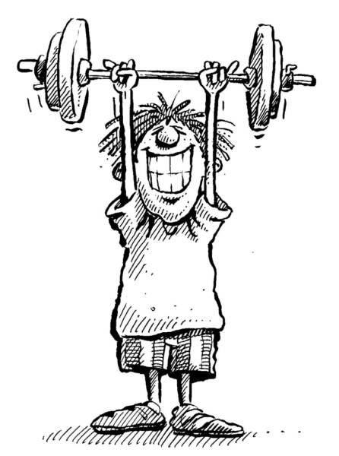
What is Energy?
Samuel DuPont 2009
Energy is..
  The ability to do work

Slide 3

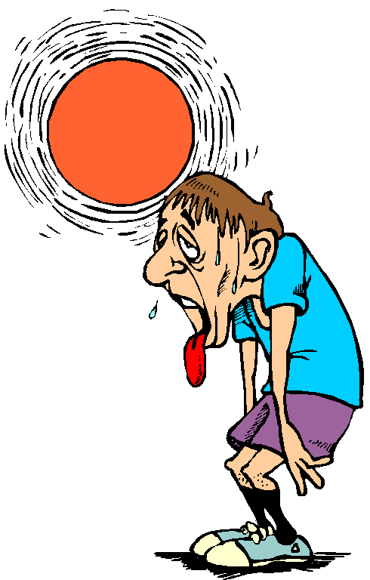
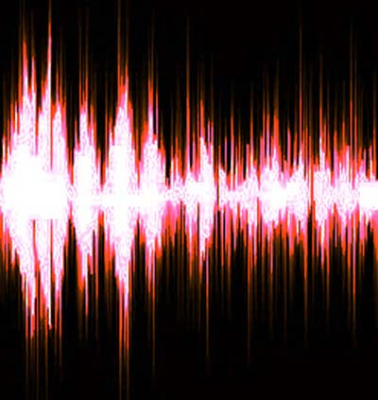
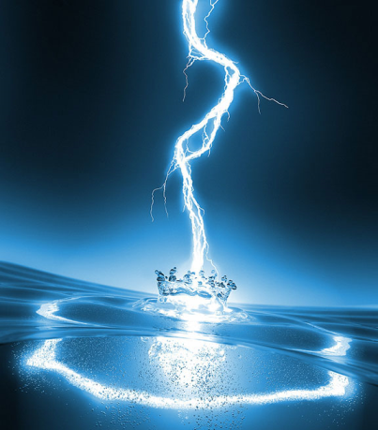
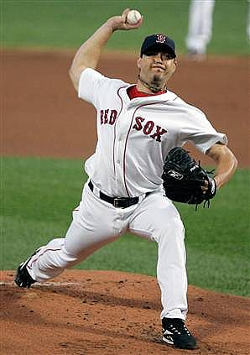
Are there different types of energy?
Samuel DuPont 2009
Light
Heat
Sound
Electrical
Motion

Slide 4
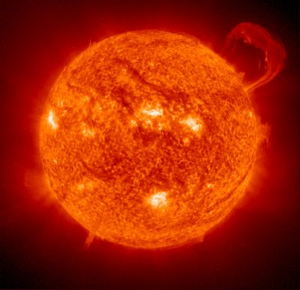
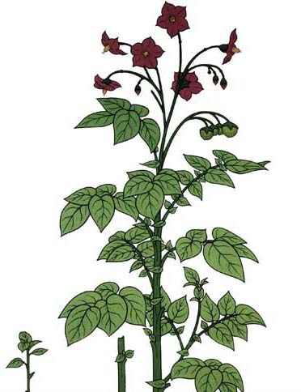
I see the Light!
Samuel DuPont 2009
Example of Light Energy:
The Sun
Question?
  Does the sun also have another form of energy?
  HEAT!
Fun Fact:
Plants use light energy to grow!

Slide 5
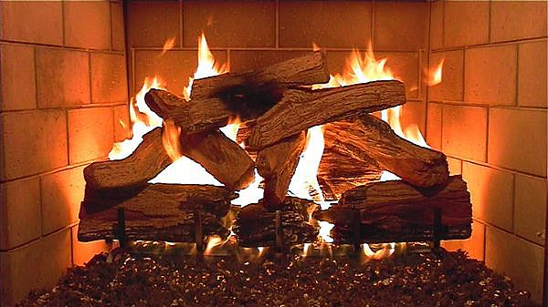
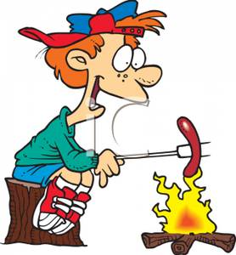

Is it getting Hot in here?
Samuel DuPont 2009
Example of Heat Energy:
Burning (Fire)
    Combustion is another word for Burn
Question:
What kind of “Work” can heat do for us?
Cooking
Keep us Warm

Slide 6



Sounds like energy to me
Samuel DuPont 2009
Example of Sound Energy:
Did you know:
Sound energy can break things like glass
Music
Notes:
Truerta.com

Slide 7
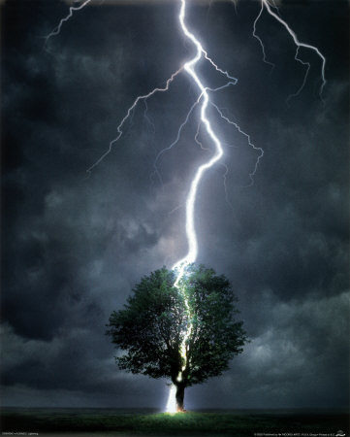



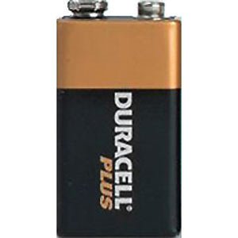
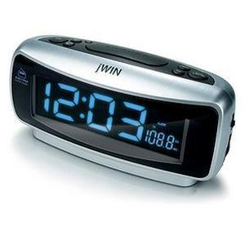
Now this is Electric!
Samuel DuPont 2009
Example of Electrical Energy
We use Electrical energy everyday!
Lighting

Slide 8
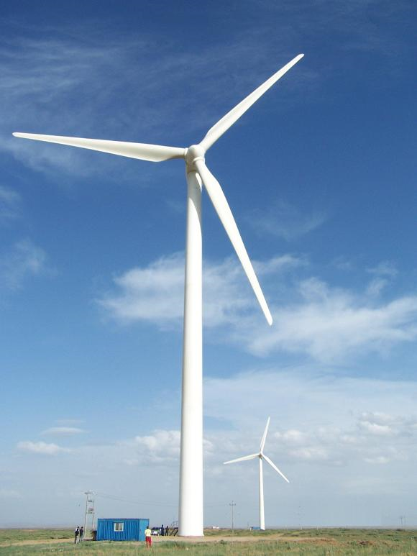

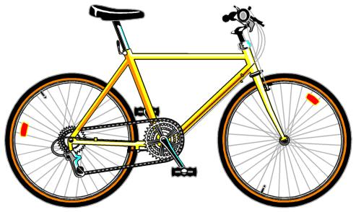
How can Energy move me?
Samuel DuPont 2009
Example of Motion Energy:
Energy of Motion is Everywhere!
Moves us around
Build things
Windmill

