Slide 1
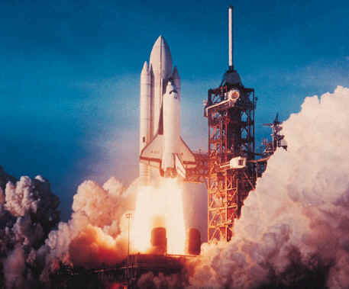
Laws of Motion
Mandek Richardson
University of South Florida
STARS Program

Slide 2

Vocabulary
Inertia
Position
Speed
Velocity
Acceleration
Momentum

Slide 3

Position
The location of an object in space and it always depends on a frame of reference
What words describe position?
East
West
Above
Below

Slide 4
Speed
Speed is the distance an object travels in a certain amount of time
  Tells you how quickly or slowly something is moving

Slide 5
Velocity
Velocity is the measure of an objects speed in a certain direction
  Must know a direction something is moving to know its velocity
5 miles/hr, east
5 miles/hr, west
5 miles/hr, north

Slide 6
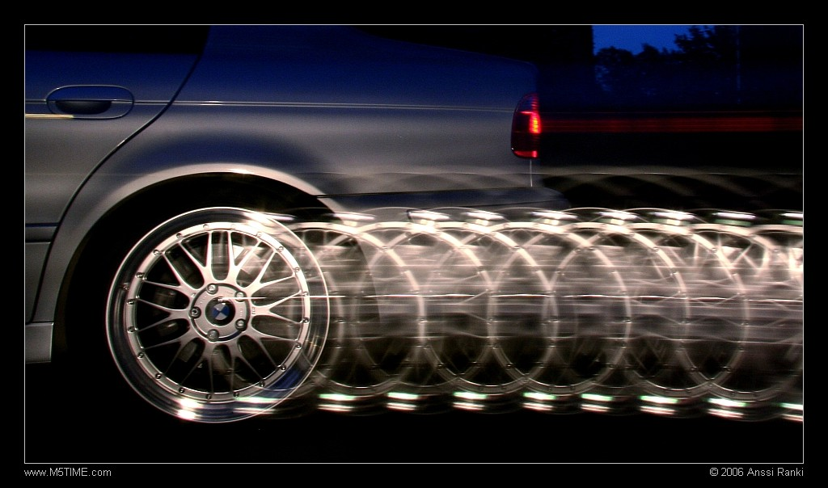
Acceleration
How fast an object’s velocity changes over time
An object accelerates when it slows down or speeds up

Slide 7
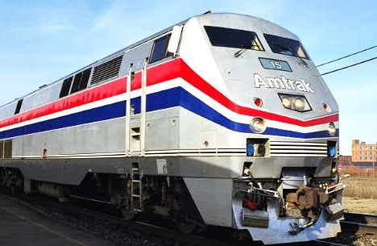
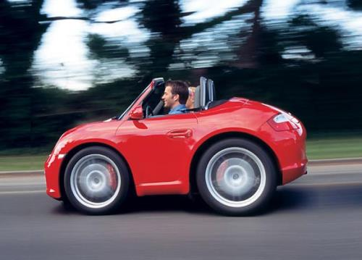
Momentum
Momentum describes how hard it is to slow down or stop an object
What’s harder to stop?
or

Slide 8
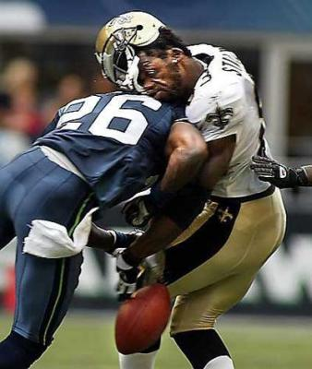
Momentum
Momentum can also describe how an object will affect something that it bumps into
Lots of momentum!

Slide 9
Momentum
Momentum = mass x velocity

Slide 10

Newton’s Laws of Motion

Slide 11
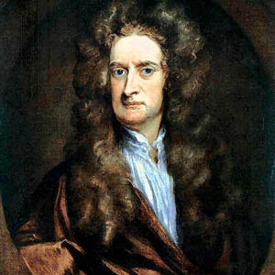
Who is Newton?
Newton is probably the most famous scientist of all time. He did a lot of work in math, optics and physics. He is most known for his laws of motion and his law of gravitation.
1641-1727

Slide 12
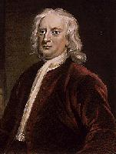
Newton’s First Law
Newton’s First Law of Motion
  An object at rest will remain at rest and an object in motion will continue moving at a constant velocity unless acted upon by a net force.

Slide 13
Newton’s First Law
Newton’s First Law of Motion
  “Law of Inertia”
Inertia
  tendency of an object to resist any change in its motion
  increases as mass increases

Slide 14
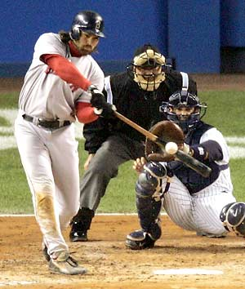
Newton’s First Law
How come the baseball doesn’t go on forever?

Slide 15
Newton’s Second Law
Newton’s Second Law of Motion
  The acceleration of an object depends on the object’s mass and the force applied to it
F = ma

Slide 16


Newton’s Second Law
The larger the force applied to an object the greater the acceleration
Less an object’s mass the less force needed to move it

Slide 17
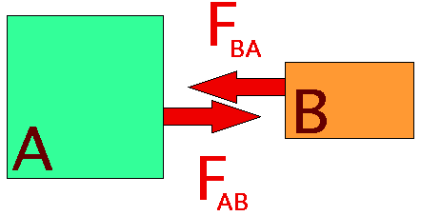
Newton’s Third Law
Newton’s Third Law of Motion
  When one object exerts a force on a second object, the second object exerts an equal but opposite force on the first.

Slide 18
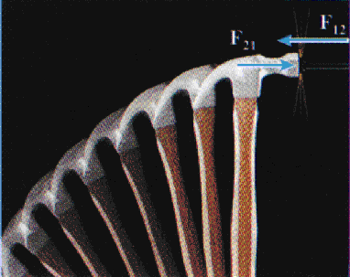
Newton’s Third Law
Action-Reaction Pairs
The hammer exerts a force on the nail to the right.
The nail exerts an equal but opposite force on the hammer to the left.

Slide 19

Newton’s Third Law
Action-Reaction Pairs
The rocket exerts a downward force on the exhaust gases.
The gases exert an equal but opposite upward force on the rocket.
F_{G}
F_{R}

