Slide 1
Do We Remember…
Matter
  Where is Matter?
  Two Things Matter Must Have?
  Three States of Matter?
Mass
  How Do We Know if Mass is Conserved?

Slide 2
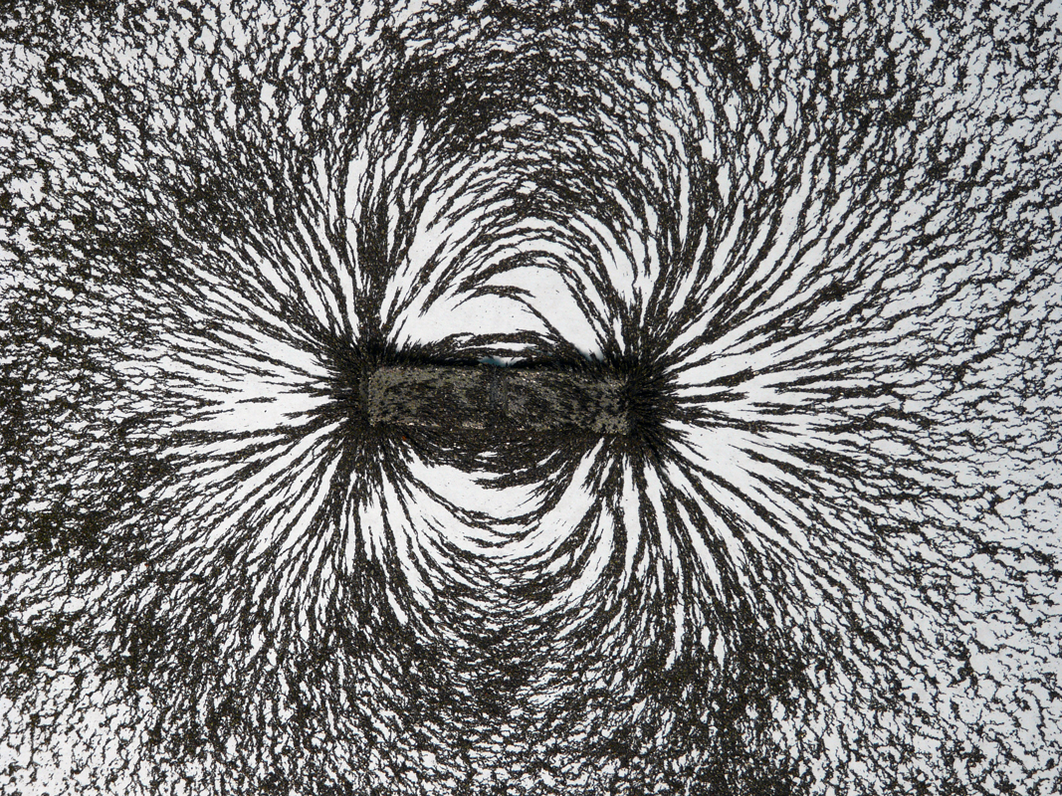
What is this?
Hint: Its probably on your refrigerator
?

Slide 3
Magnets….!
Welcome to the World

Slide 4
New Vocabulary!
Magnet
Magnetism
Attract
Repel
Pole

Slide 5
Attract
Come Together

Slide 6
Repel
Push Apart

Slide 7

Magnet
What is a magnet?

Slide 8
Magnetism
What is Magnetism
  A Property of Matter
  All Magnets have it

Slide 9
What is a Pole?
North and South
S
N
What else has a North and a South Pole???

Slide 10
Magnet
A Magnet..
  Has 2 “poles”
    North
    South
  Attracts
    things with Iron (Fe)
    And other Magnets!

Slide 11
Do Magnets attract other Magnets?
S
S
N
N
S
S
N
N
Opposites Attract!
S
S
N
N
S
S
N
N
Like Repels!

Slide 12

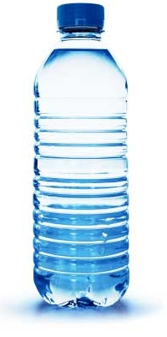
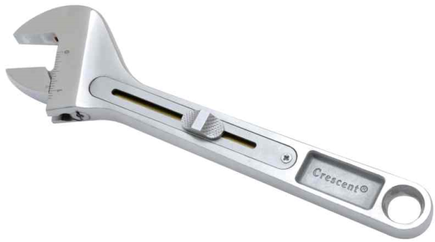
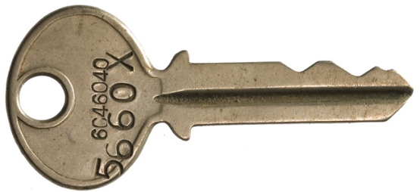


What Do Magnets Attract?

Slide 13
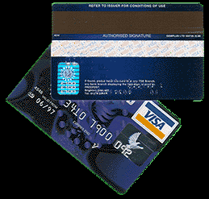
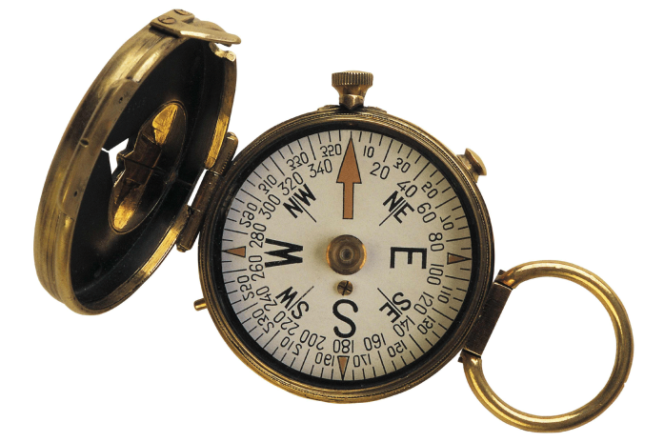
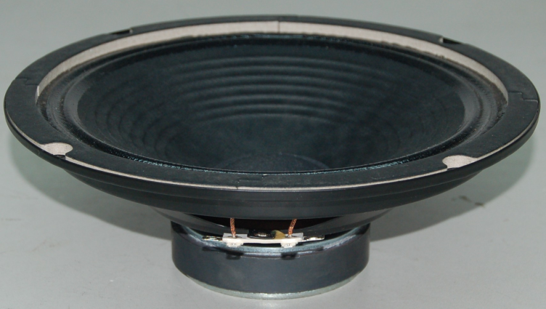
Where Are The Magnets?
Magnets are used everyday.
Compass
Speaker
Credit Card

Slide 14
Where else do we use Magnets?
Space
  So things do not float away!

Slide 15
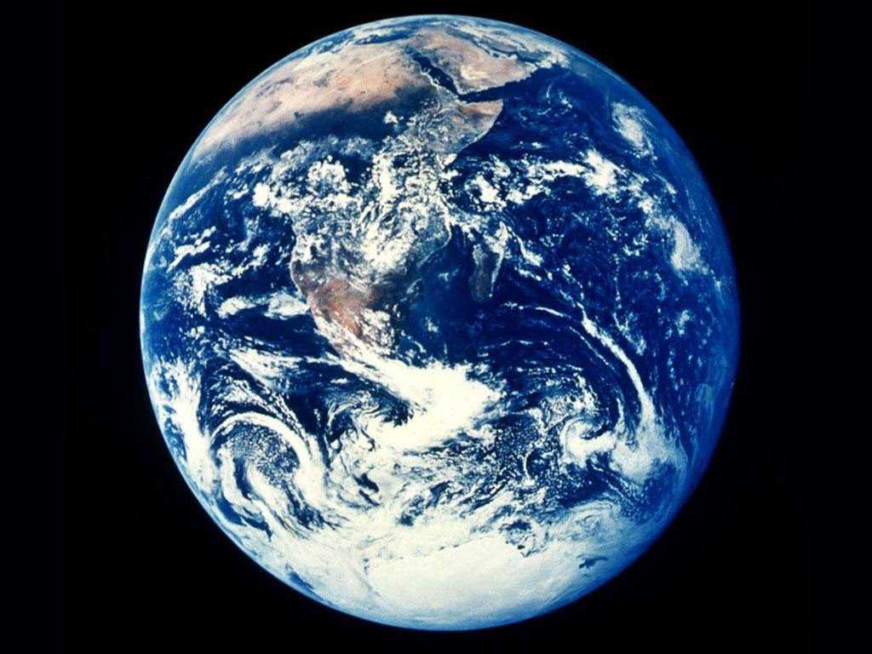
Is The Earth a Magnet?

