Slide 1
Colligative properties
By Ryan Cates
Students, Teachers, And Resources in Sciences (STARS)
University of South Florida
College of Engineering
Notes:
Javier

Slide 2
What is a colligative property
Properties of solutions that depend on the number of molecules in a given volume of solvent and not on the properties (e.g. size or mass) of the molecules.
  This property can change the boiling or freezing point of solutions
Boiling Point_{total} = Boiling Point_{solvent} + ΔT_{b}

Slide 3
Example: Boiling of water
Solution | Freezing Temp | Boiling Temp
Water | 0°C | 100 °C
Water + 1 part salt | -5 °C | 105 °C
Water + 2 parts salt | -10 °C | 110 °C
http://z.about.com/d/chemistry/1/0/5/a/demonstration.jpg

Slide 4
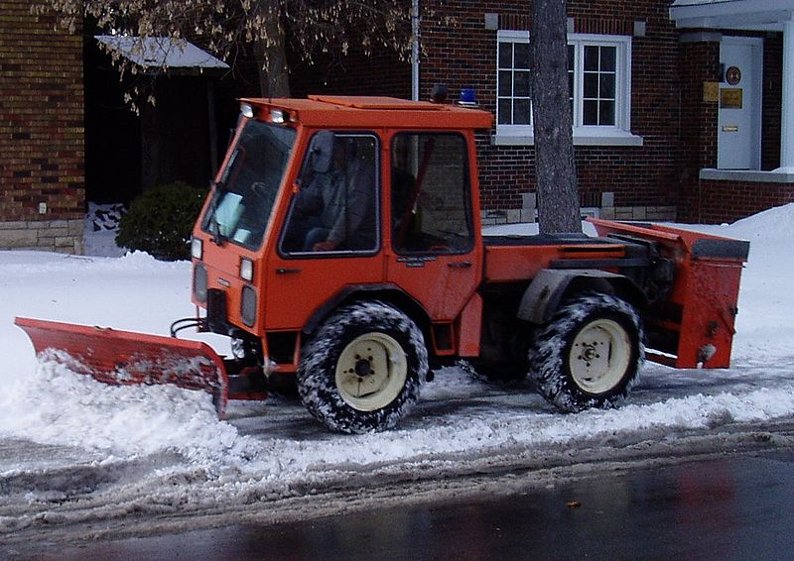
Freezing Point Depression
http://en.wikipedia.org/wiki/File:Sidewalk_plow.JPG

Slide 5
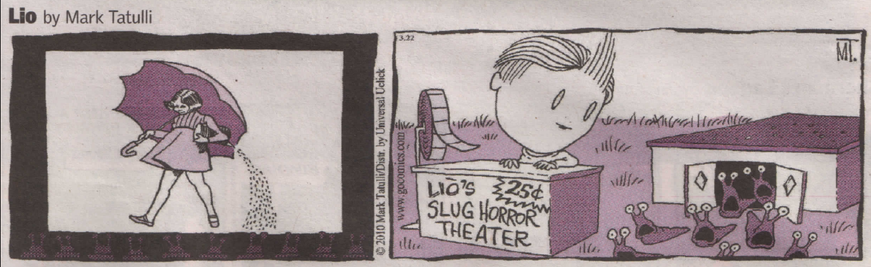
End

