Slide 1
Nutrition: Part 1
Calories & Portion Sizes
Mandek Richardson
STARS
University of South Florida

Slide 2

Calories
What is a calorie?
  A calorie is a scientific way of measuring energy.

Slide 3
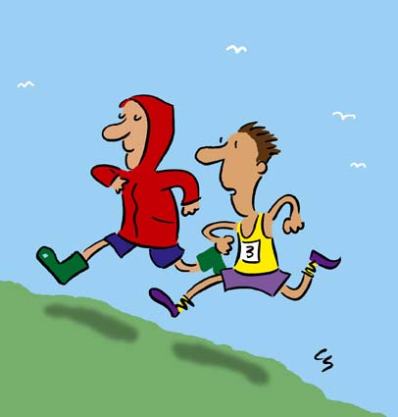
Review Time
Do you remember what energy is?
  Energy is the ability to do work or to move an object

Slide 4

Calories
Why do we need calories?
  We need energy in order for our body to stay active and to perform necessary functions like breathing, digestion, etc.

Slide 5
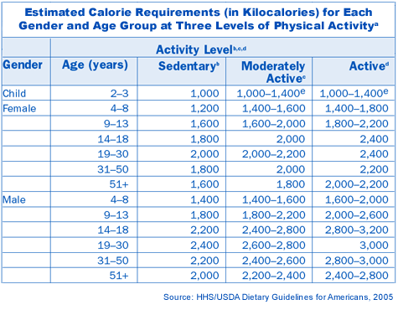
Calories
How many calories do we need to stay alive?

Slide 6


Calories
What happens when you eat too little or too many calories
Not enough calories you lose weight
Too many calories you gain weight

Slide 7
Calories
How many calories would you need to cut to lose 1 pound of fat?
Answer: 3500 calories

Slide 8

Calories
How do scientist define calories?
  A calorie is the energy needed to raise the temperature of 1 gram of water by 1 degree Celsius

Slide 9
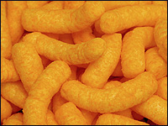
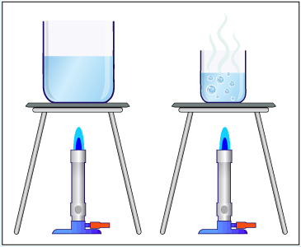
Calories
How would you calculate the number of calories in cheese curls?
Hint you will need this

Slide 10
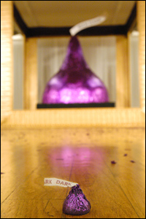
Calories/Energy/Work
How much energy does this piece of chocolate contain?
It contains 26 calories
That’s enough energy to lift an SUV over 6 feet in the air!

Slide 11
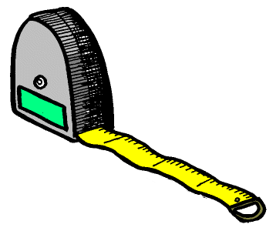
Do all food measure up?

Slide 12
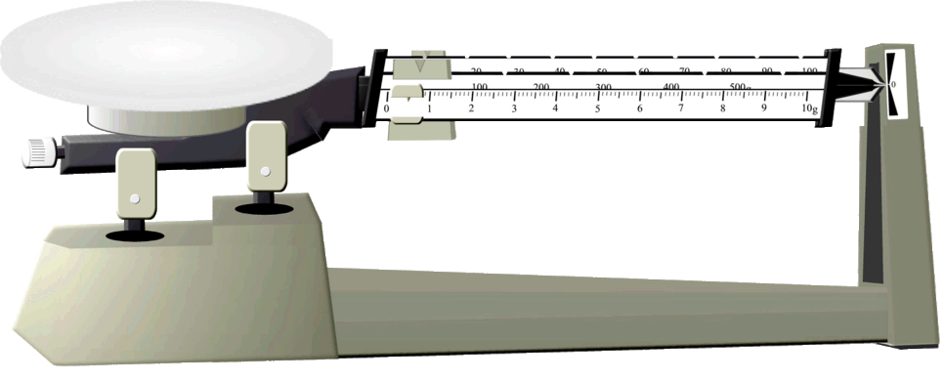
Eat This Not That!
1 gram of carbohydrates = 4 calories
1 gram of protein = 4 calories
1 gram of fat = 9 calories

Slide 13
