Slide 1
Vertebrates!
A Review

Slide 2
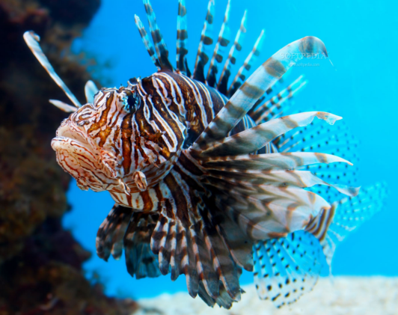
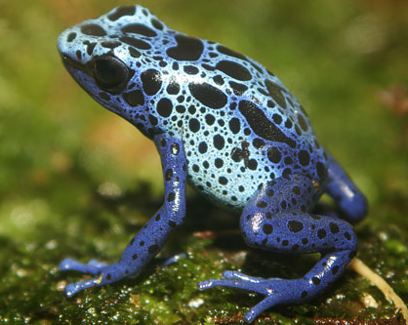

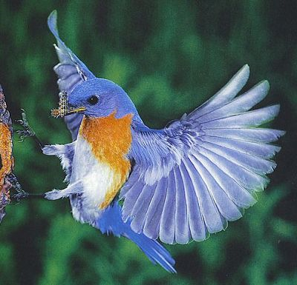
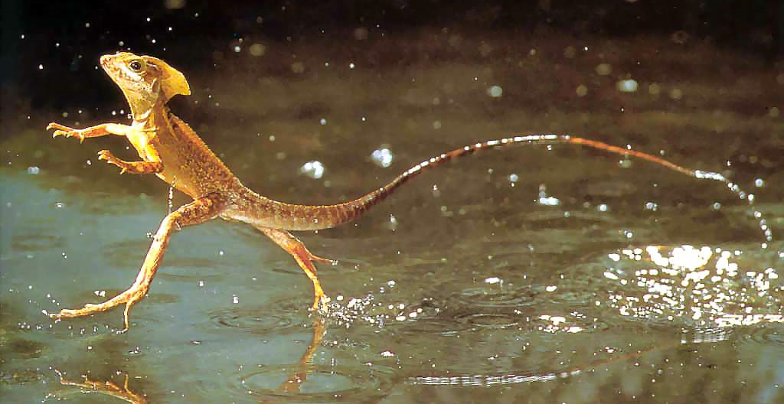
Can you Name the 5 Types?
Fish
Amphibians
Reptiles
Birds
Mammals

Slide 3
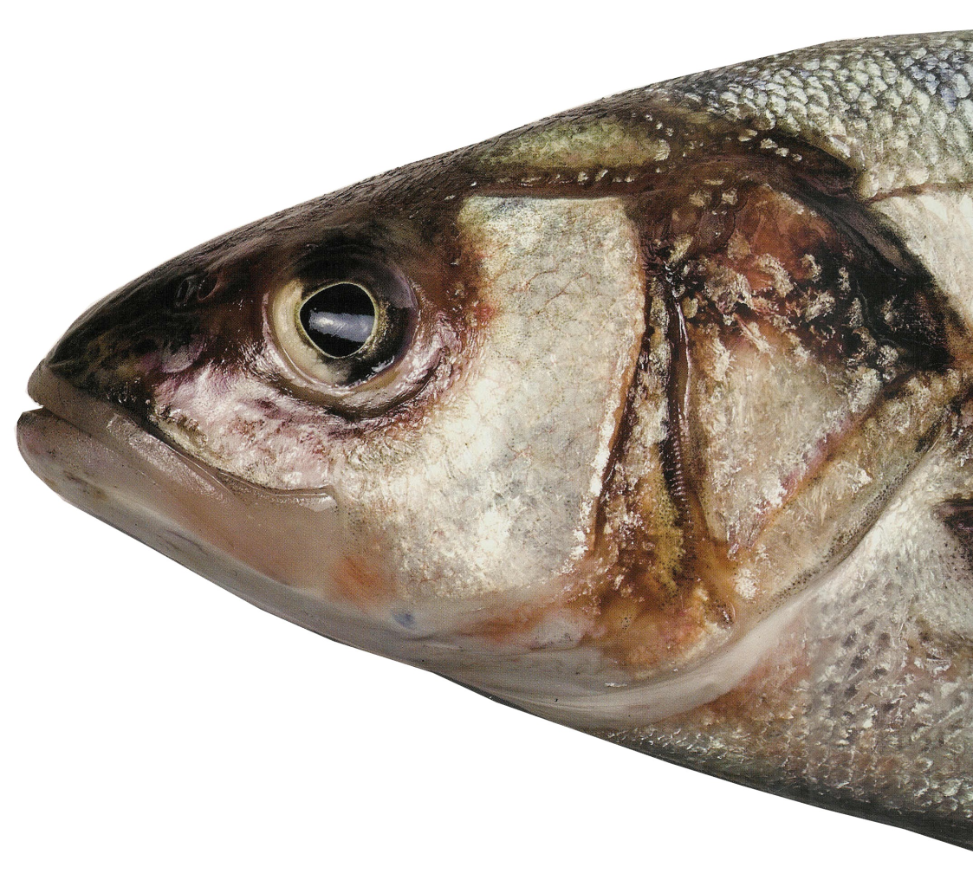
Fish!
What makes it a Fish?
  Vertebrate
  Cold Blooded
  Scales
  Lives in the Water
  Use gills to breathe
    Most
  Lays Eggs
  Two sets of paired fins

Slide 4
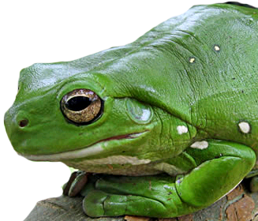
Amphibians
What makes it an Amphibian?
  Vertebrate
  Lays eggs in water
  Has 4 legs
    Usually
  Breath in Water when young
    Gills
  Breath Air when mature
    Lungs
Examples: Frogs, toads, newts, and salamanders

Slide 5
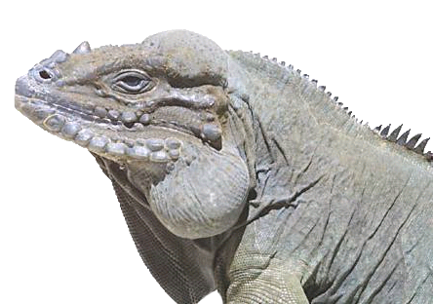
Reptiles
What makes it a Reptile?
  Vertebrate
  Cold Blooded
  Scales
  Lay eggs
  Breathes Air
    Lungs
Examples: Snakes, Lizards, Crocodiles, and Turtles

Slide 6
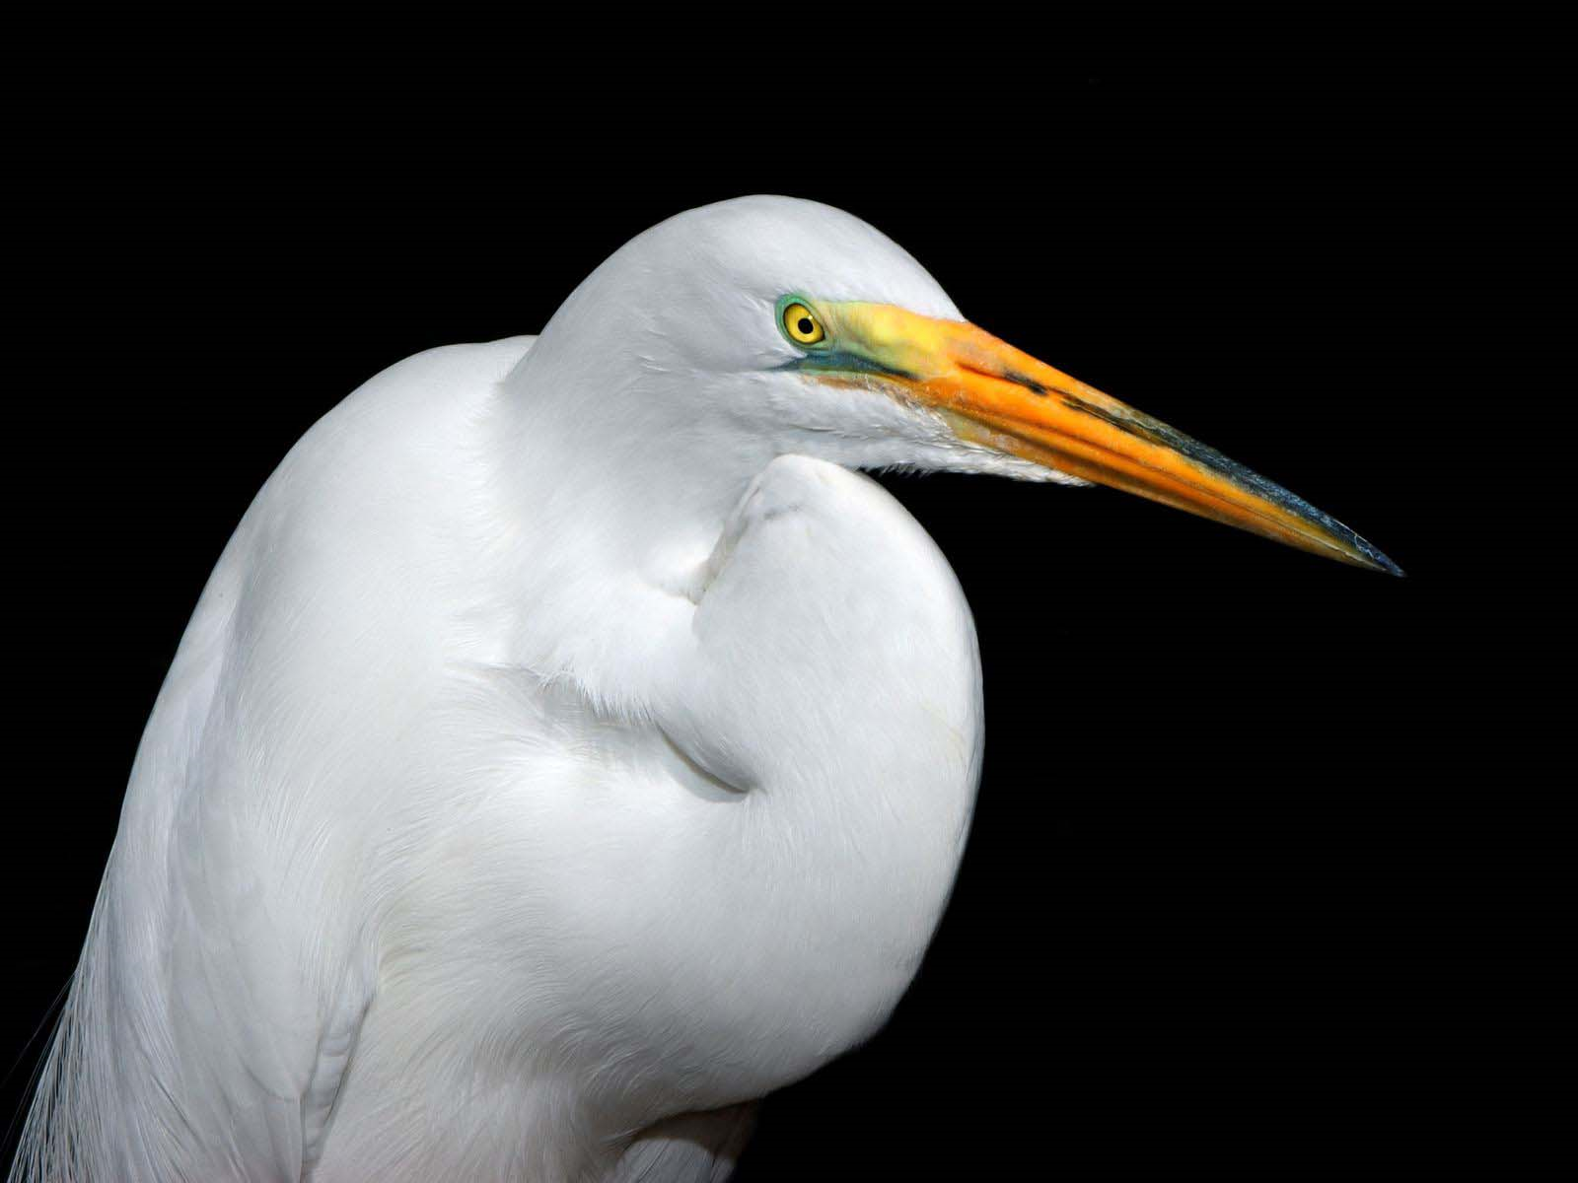
Birds
What Makes it a Bird?
  Vertebrate
  Warm-blooded
  Covered in Feathers
  Breathe Air
    Lungs
  Lay eggs

Slide 7

Mammals
What makes it a Mammal?
  Vertebrate
  Warm-blooded
  Live Birth
  Breathes air
    Lungs
  Hair or Fur

Slide 8
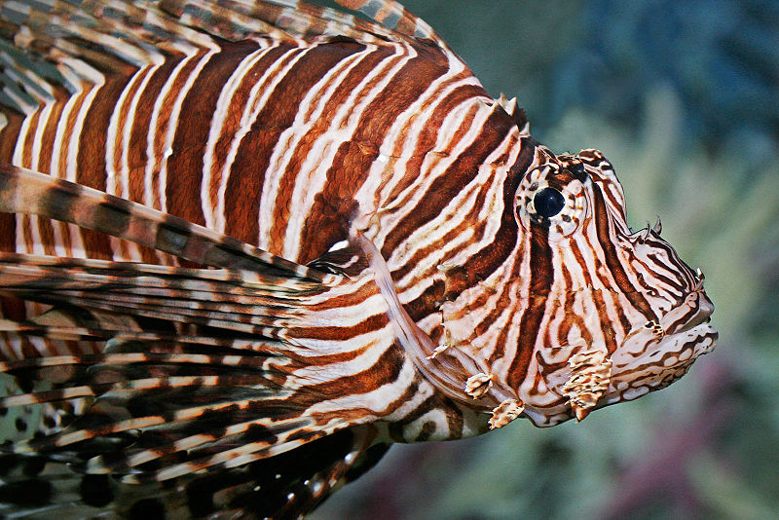
Can you Figure me out?
I live in the water
I breathe with gills
I lay Eggs
I have scales all over my body
FISH!

Slide 9
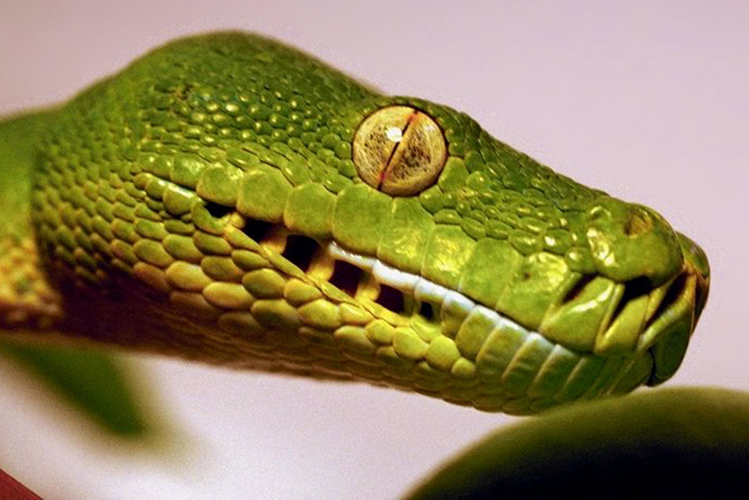
Can you Figure me out?
I live mostly on the land
I have scaly skin
I need the sun to keep warm
I only breathe air
Reptile!

Slide 10
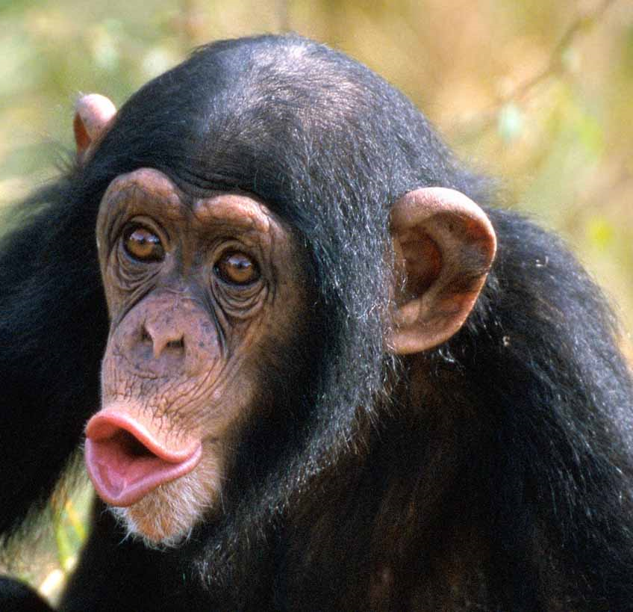
Can you Figure me out
I have a vertebrate
I am warm-blooded
I breathe air
I do not lay eggs
Mammal!

