Slide 1
Time

Slide 2
How do we measure time?
Seconds
Minutes
Hours
Days
Months
Years

Slide 3

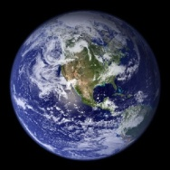
Lets go to : Outer Space!
Revolution
Rotation

Slide 4
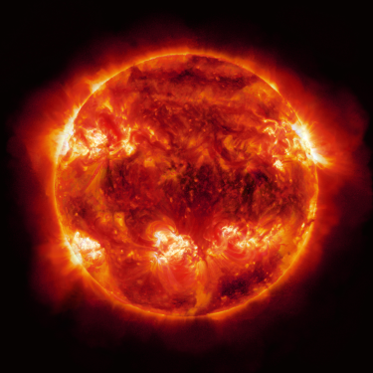
Why are there 24 Hours in a Day?
Because it takes 24hours for earth to complete one rotation
Rotation

Slide 5
What is a Month
The time it takes for the moon to Revolve around the Earth about once.
Revolution

Slide 6

What is a Year?
It takes one Year for the earth to Revolve around the sun

Slide 7
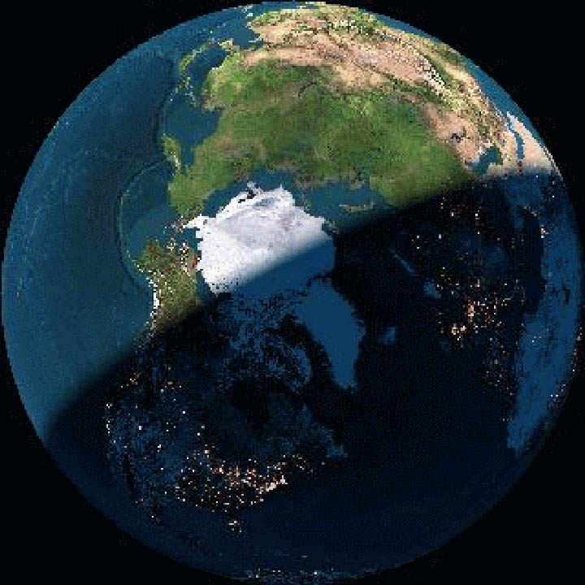
The line between day and night
It is always daytime somewhere on earth!
Day time
Nighttime

Slide 8
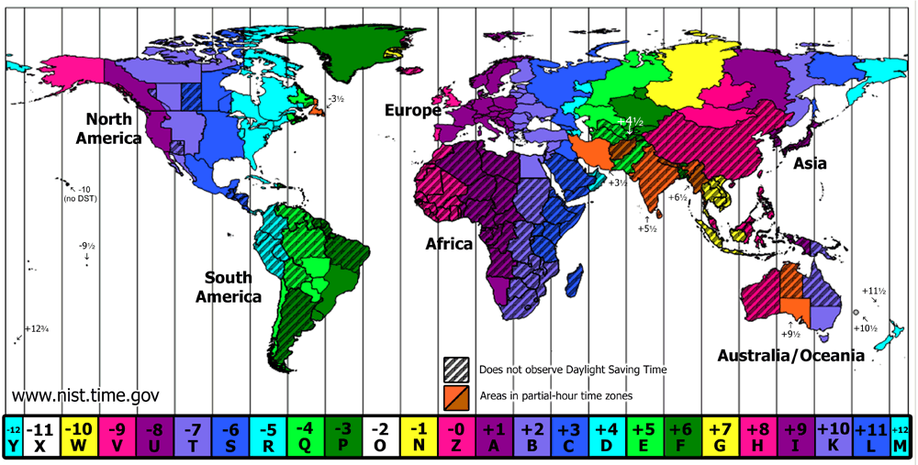
Time Zones!

Slide 9
Review
What’s the Difference between Rotation and Revolution?
Rotation
or
Rotating
Revolution
or
Revolving

Slide 10
Review
What is a month?
  About how long it takes for the moon to________ around the earth.
What is a day?
  How long it takes the earth to _______ once.
What is a year?
  How long it takes the earth to ________ once around the sun
revolve
rotate
revolve

