Slide 1
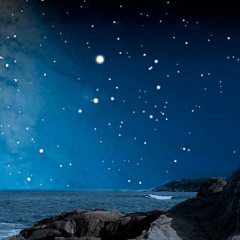
What else is in the sky?

Slide 2
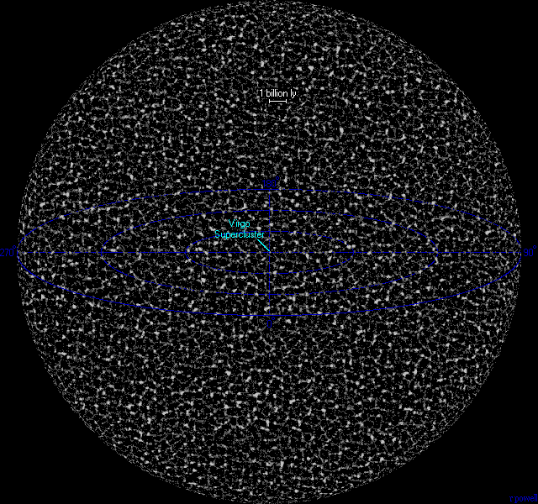
The Universe

Slide 3
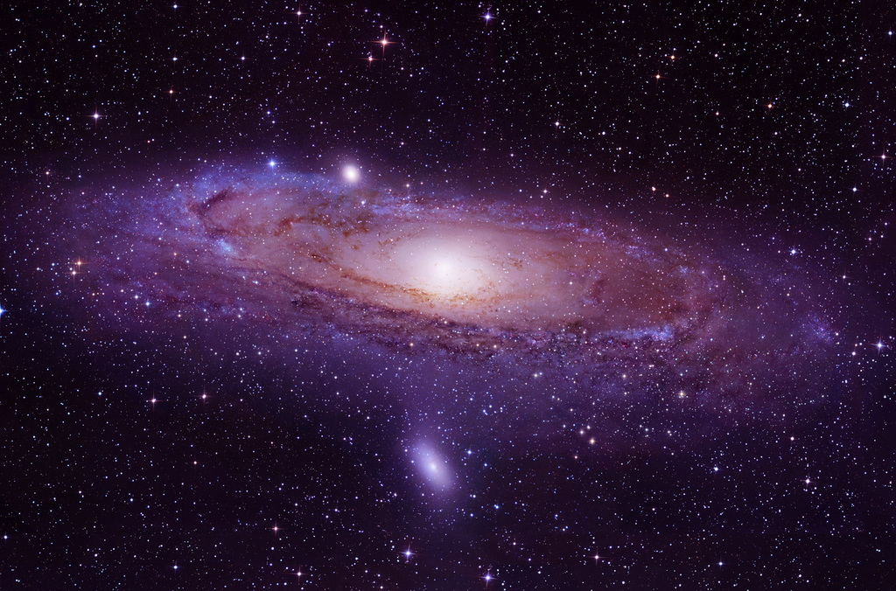
Th
The Universe is everything
that exists in space

Slide 4
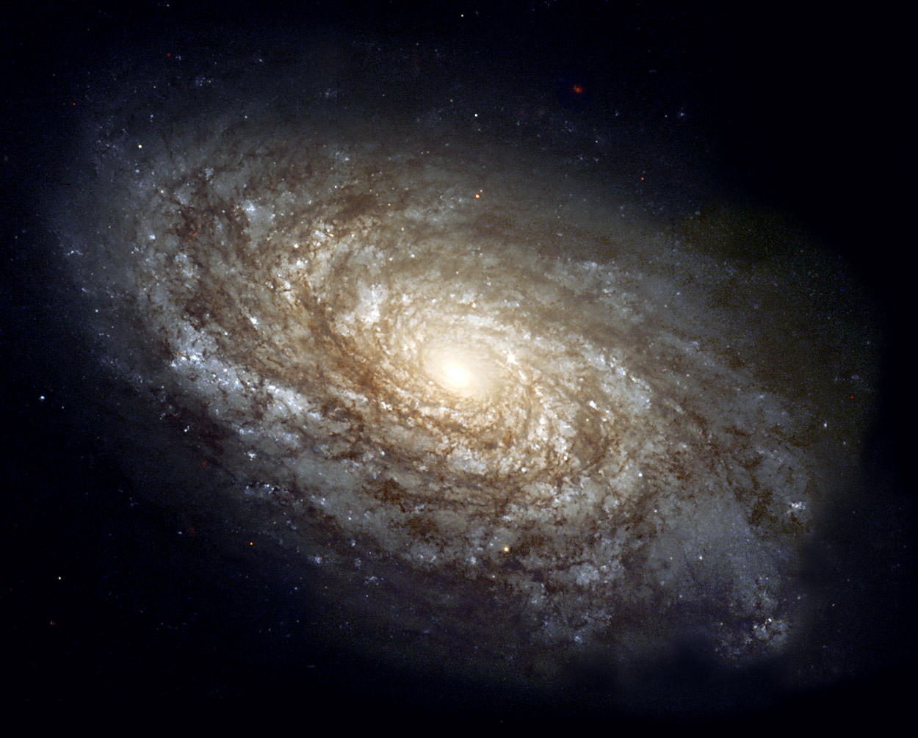
Galaxies

Slide 5
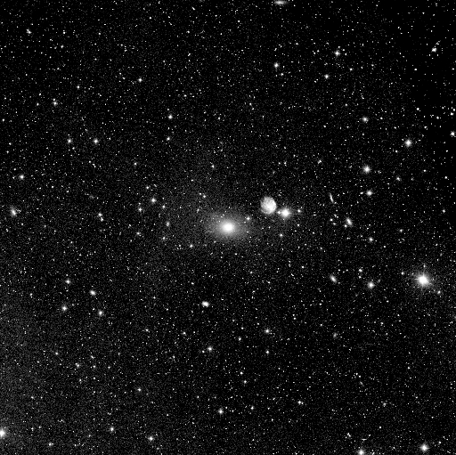

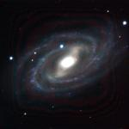
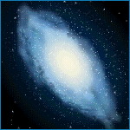
Galaxies and Shapes (…Cont.)
Spiral galaxies: can be broken down in two categories
    Circular spiral - round center
    Barred Spiral – bar center
Elliptical galaxies: are shaped like an egg.

Slide 6
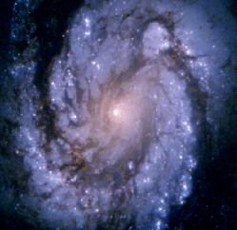

Galaxies!
It is estimated that there are billions of other galaxies in the universe.
The Milky Way
(the name of our GALAXY…and a delicious candy bar )
is the band of light that is produced by the thousands of stars that lie in the main section of our Galaxy.
We are a spiral galaxy.

Slide 7
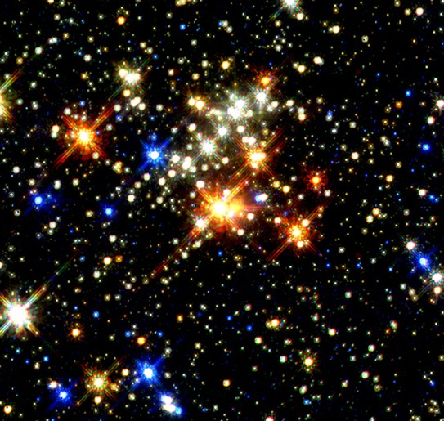
STARS

Slide 8
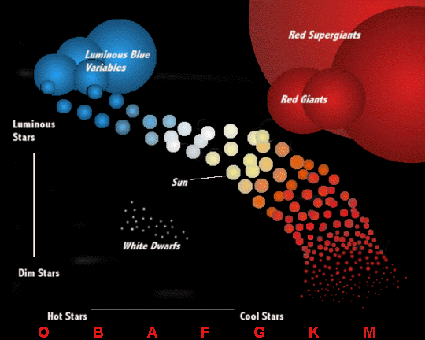
Star color & temperature

Slide 9
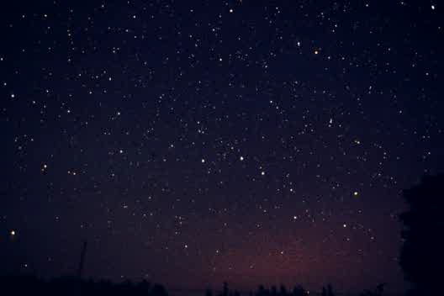
Star Attractions: Constellations
What do you see when you look up into the sky?
    Humans have seen group of stars that looks like imaginary animals, people, or mythological beings in patterns of star groupings.
Ancient stargazers gave names to these groupings, as constellations.
Click twice the borders of this screen to play a background movie.

Slide 10
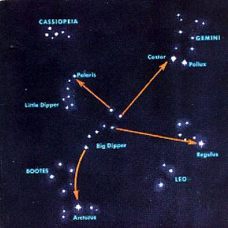
Star Constellations Examples (…Cont.)

Slide 11
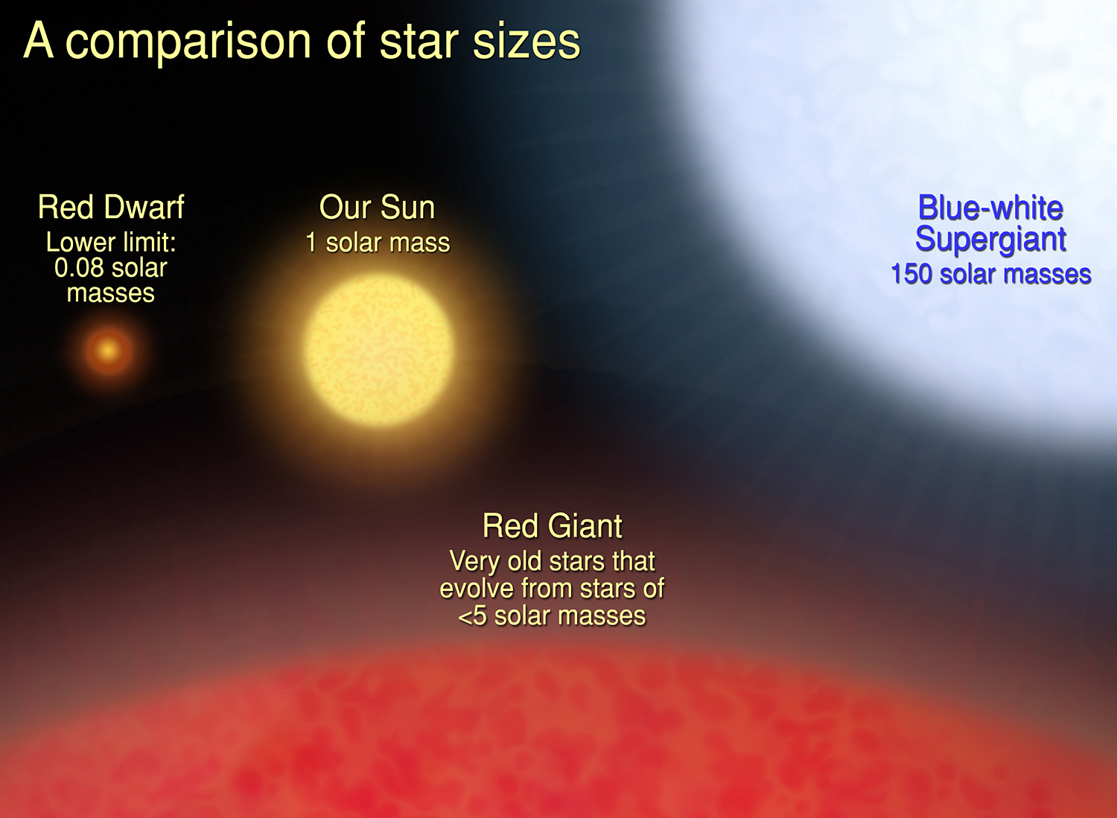
Is the sun a big star or a little
star?

Slide 12
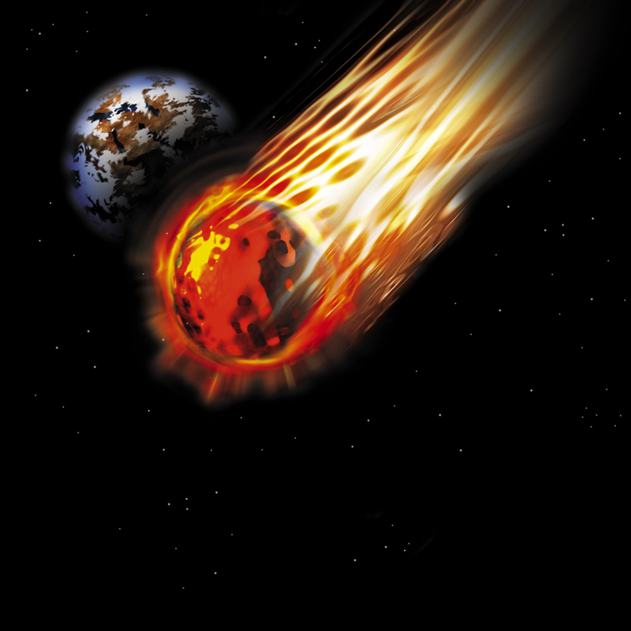
Asteroids

Slide 13
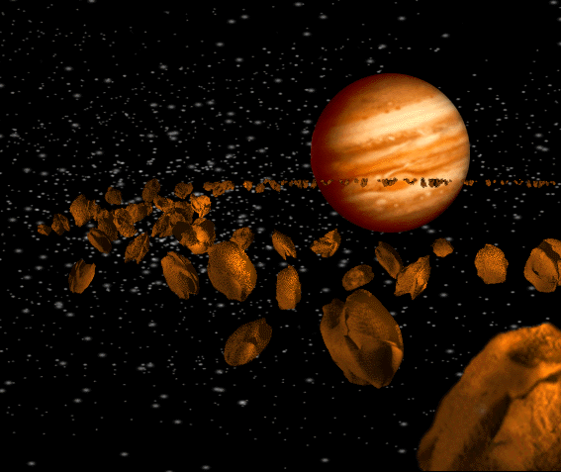
Asteroids are chunks of
rocks that never became planets

Slide 14
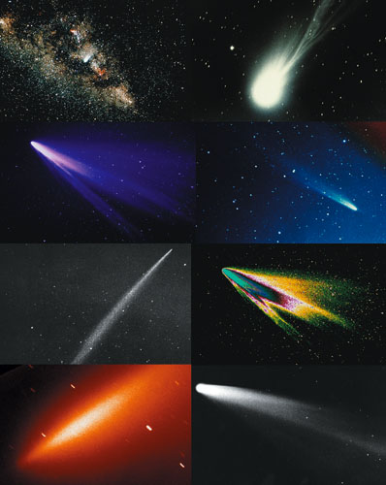
COMETS

Slide 15
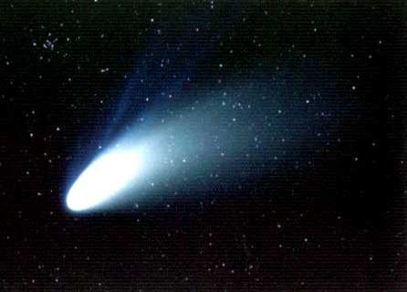
A comet is a celestial body made of dust, gases, and ices (mainly water and carbon dioxide) that moves in an extremely elongated orbit about the sun.

Slide 16
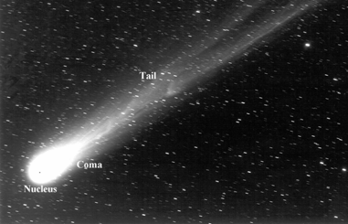
Parts of a comet, nucleus, coma and tail

Slide 17
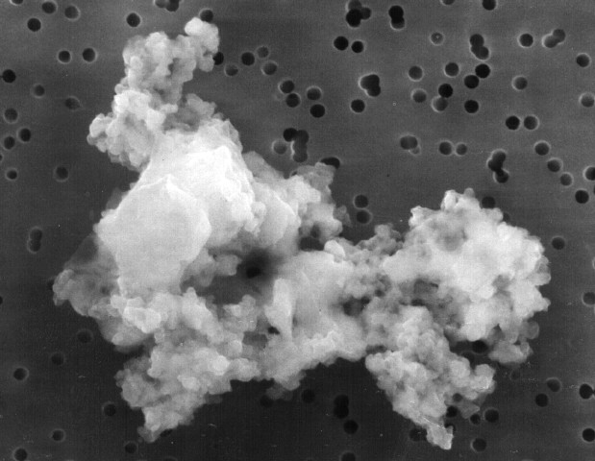
Dust
Small particles between the space of the planets.
Forms from asteroid collisions
Size is the width of a human hair

