Slide 1
Forecasting
Mandek Richardson
STARS
University of South Florida

Slide 2
How to Forecast Without Equipment
3 quick ways to forecast weather
    Clouds
    Wind
    Senses

Slide 3
Cloud Forecasting
Clouds can tell you many things about what the weather will do
Clouds come in different shapes sizes and colors
The type of cloud will tell the weather around you

Slide 4
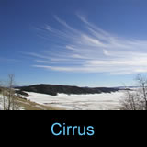
Cloud Type and Weather
Cirrus Clouds
  Thin and wispy
  Found very high in the sky
  Point in the direction of the wind
  No precipitation falls
  Sign of fair weather now and the near future

Slide 5

Cloud Type and Weather
Altocumulus
  Like fuzzy bubbles in long rows or strings
  Indicate a cold front is coming
  In summertime may turn into thunderstorms

Slide 6

Cloud Type and Weather
Nimbostratus
  Dark and low hanging clouds that cover the whole sky
  Usually will have light precipitation

Slide 7

Cloud Types and Weather
Cumulus Clouds
  Look like big cotton balls
  Have large spaces of clear sky between them
  Usually don’t carry rain
  During spring and summer can turn to Cumulonimbus clouds

Slide 8

Cloud Type and Weather
Cumulonimbus Clouds
  Thunderstorm clouds
  Tall & Wide
  Usually have heavy rain and lightning
  If you see them it will rain very soon

Slide 9
Wind Forecasting
Wind Forecasting is simple and easy
Early in the morning the wind will tell you how warm the day will be
However the wind has to be strong enough for you to feel it

Slide 10
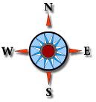
Direction and Weather
First find north and face it
Wind is coming from the south warm weather is on its way
Wind is coming from the north cooler and dry weather is on its way
East and west moving wind mean a variety of things

Slide 11


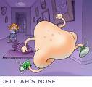

Senses and Weather
How can you use your 4 senses to forecast weather?

