Slide 1
Disclaimer
This presentation may contain copyrighted material.
PLEASE DO NOT DISTRIBUTE

Slide 2
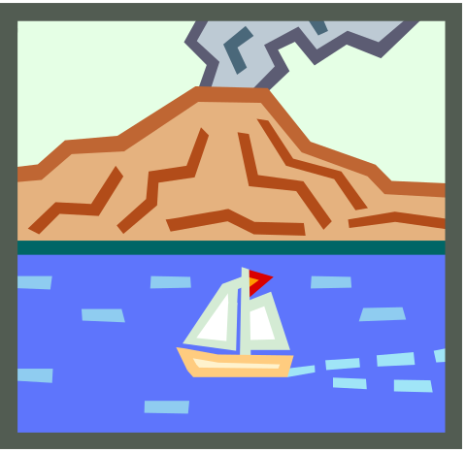
Plate Tectonics, Volcanoes, Earthquakes and Tsunamis
Dayna Lee Martínez
STARS
University of South Florida
Maniscalco Elemmentary

Slide 3
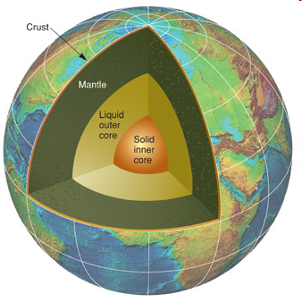
Earth’s Layers
Inner core
  Iron and nickel
  Hot but the great pressure at the center of the earth keeps the inner core solid
Outer core
  Liquid iron
Mantle
  Upper mantle
  Lower mantle
  Mostly solid rock but some may be liquid
Crust
  Surface layer of the Earth

Slide 4
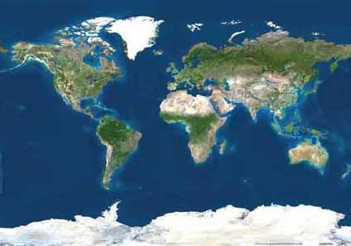
Plate Tectonics
When you look at a map of the world, it seems as though it was always like that
But really all of the dry land on Earth moves around like islands about 60 miles thick on top of hot, mushy rock in the mantle

Slide 5
Plate Tectonics
Land masses move around the way bath toys move around in the bathtub
The land masses move very slowly - usually no more than twenty centimeters in a year
Like the bath toys, sometimes the land masses are all clumped together in one part of the Earth, and other times they drift apart
This has happened at least three times since the dry land masses first appeared on Earth about four billion years ago
When the land masses run into each other, or slide under each other, it causes earthquakes and volcanoes, and sometimes huge mountain chains, like the Alps or the Himalayas, get pushed up high above sea level

Slide 6
Plate Tectonics
The land masses are still moving today
  North America and South America are gradually moving away from Europe and Africa, so that the Atlantic Ocean is getting bigger and the Pacific Ocean is getting smaller
  The California edge of the Pacific Ocean is ramming into North America and sliding past it, causing earthquakes in California and forming the Rocky Mountains
In several hundred million years, the Pacific Ocean will disappear, and the West Coast of North America will smash into Japan and China, forming another large land mass, and probably another large mountain range

Slide 7
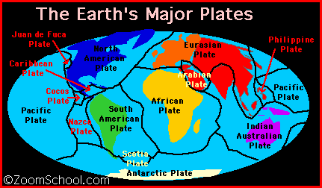
Plate Tectonics

Slide 8
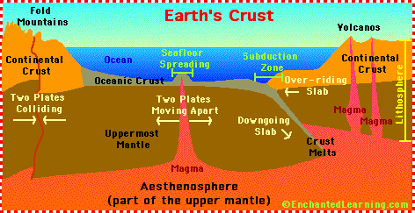
Plate Tectonics

Slide 9
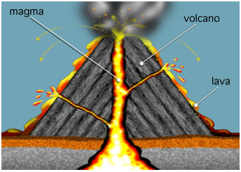
Magma, Lava and Volcanoes
Magma is molten (melted) rock beneath Earth's surface
Lava is molten (melted) rock that reaches Earth's surface
A volcano is a mountain made of lava, ash, or other materials from eruptions that occur at an opening in Earth's crust

Slide 10
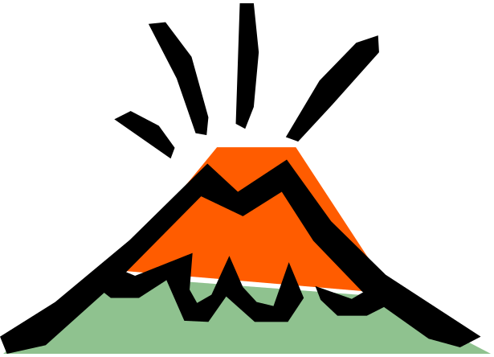
Facts about Volcanoes
Volcanoes are like giant safety valves that release the pressure that builds up inside the Earth
As pressure in the molten rock builds up it forces its way up “fissures” which are narrow cracks in the earths crust

Slide 11
Volcanic Eruptions
Volcanoes can have a very serious effect on the lands and people around them when they erupt
  Buildings are destroyed and people are made homeless
  People may die
  Clouds of ash cover plants making them inedible
  Poisonous gases kill people and animals
  Dust causes pneumonia and illnesses to the survivors
  Dark skies, severe winds and heavy rains may follow an eruption for months afterwards
People can get used to living near a volcano, but it is always a little dangerous
People set up homes on the slopes of volcanoes because of the rich, fertile soil produced

Slide 12
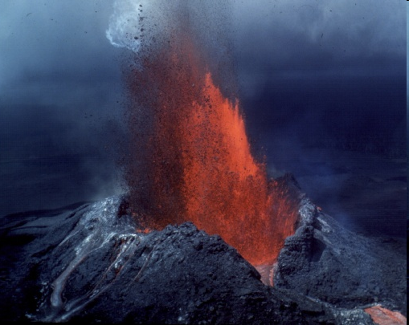
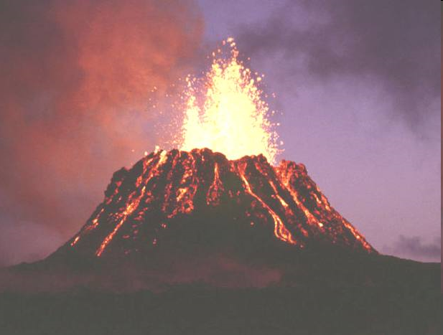
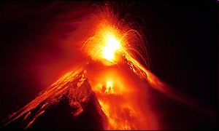
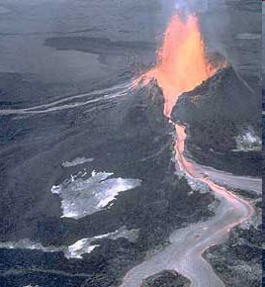

Slide 13
Types of Volcanoes
Cinder Cone Volcanoes
Composite or Strato Volcanoes
Shield Volcanoes

Slide 14
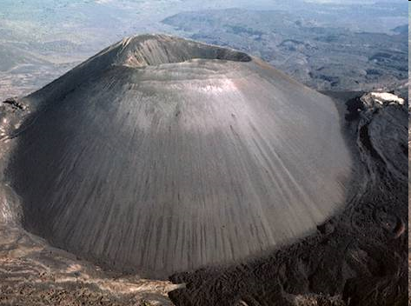
Cinder Cone Volcanoes
Formed when ashes and cinders are blown out of a single vent, quickly forming a small cone-shaped mountain
Not made of lava

Slide 15
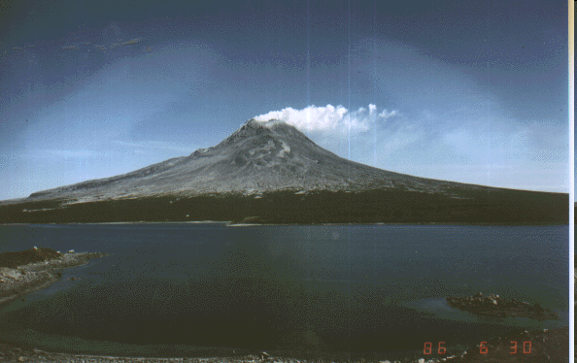
Composite or Strato Volcanoes
Magma is pushed to the surface through multiple cracks or vents in the crust
Wide with steep slopes
Made of lava that hardens after an eruption

Slide 16
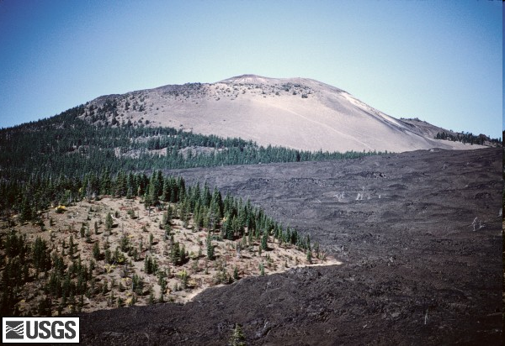
Shield Volcanoes
Broad volcanoes with gentle slopes
Formed by lava that flows easily

Slide 17
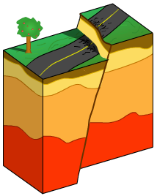
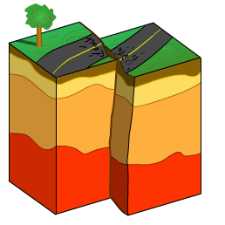
Earthquakes
Earthquakes happen when the moving tectonic plates that make up the surface of the Earth move apart or bump into each other, or slide under each other
This movement tears apart the surface of the Earth, or crunches it up

Slide 18
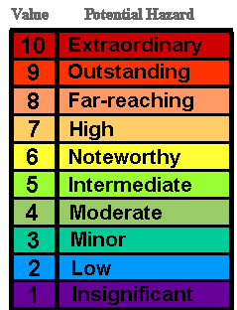
Ritcher Scale
Notes:
9.0 — Causes complete devastation and large-scale loss of life.
8.0 — Very few buildings stay up. Bridges fall down. Underground pipes burst. Railroad rails bend. Large rocks move. Smaller objects are tossed into the air. Some objects are swallowed up by the earth.
7.0 — It is hard to keep your balance. The ground cracks. Roads shake. Weak buildings fall down. Other buildings are badly damaged.
6.0 — Pictures can fall off walls. Furniture moves. In some buildings, walls may crack.
5.0 — If you are in a car, it may rock. Glasses and dishes may rattle. Windows may break.
4.0 — Buildings shake a little. It feels like a truck is passing by your house.
3.0 — You may notice this quake if you are sitting still, or upstairs in a house. A hanging object, like a model airplane, may swing.
2.0 — Trees sway. Small ponds ripple. Doors swing slowly. But you can't tell an earthquake is to blame.
1.0 — Earthquakes this small happen below ground. You can't feel them.

Slide 19
Tsunamis
A large ocean wave usually caused by an underwater earthquake or a volcanic explosion.
Are NOT tidal waves.
  Tidal waves are caused by the forces of the moon, sun, and planets upon the tides, as well as the wind as it moves over the water.
With typical waves, water flows in circles, but with a tsunami, water flows straight.
  This is why tsunamis cause so much damage!

Slide 20
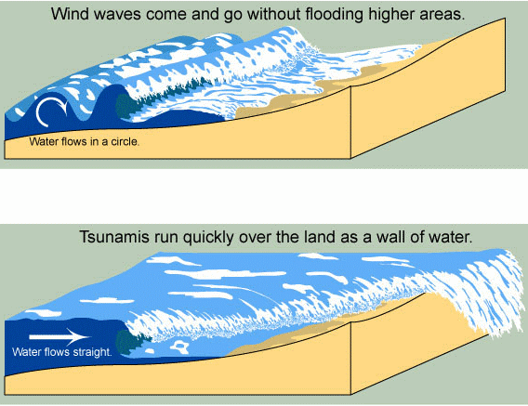
Tsunamis

