Slide 1
The water cycle
By Ryan Cates
Big Idea 7
Students, Teachers, And Resources in Sciences (STARS)
University of South Florida
College of Engineering
January 4, 2010
Notes:
Javier

Slide 2
Outline
Review
Water Cycle
  Evaporation
  Condensation
  Precipitation
How the 3 phases of matter affect the water cycle.
  Aquifers
  Glaciers
  Bodies of water
  Mountaintops
Notes:
Javier

Slide 3
Vocabulary Review
  What are Newton’s Laws of Motion?
  What are 6 types of potential energy?
  What are the steps to the experimental method?
  What is the difference between weight and mass?
  What is the difference between conductor and insulators?
  What is the summer solstice?
  Why does the Earth experience four seasons?

Slide 4
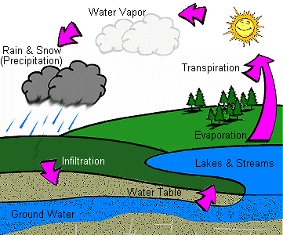
Water Cycle
http://www.dnr.state.wi.us/org/caer/ce/eek/earth/groundwater/images/groundwater.gif

Slide 5
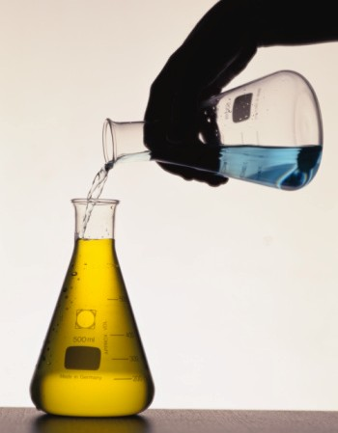
Demonstration: Evaporation, Condensation, precipitation.
http://z.about.com/d/chemistry/1/0/5/a/demonstration.jpg

Slide 6
Where does all the water come from and where does it go?
Sent from
  Aquifers
  Bodies of water
Sent to
  Glaciers
  Mountaintops
  Back to bodies of water and to the ground

Slide 7
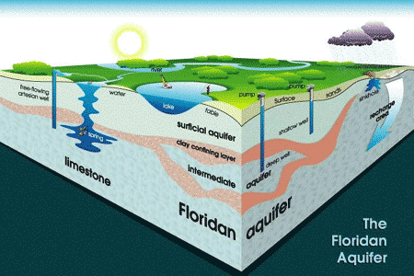
Aquifers
http://www.wec.ufl.edu/extension/gc/harmony/images/aquifer.gif

Slide 8
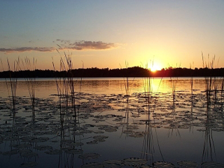
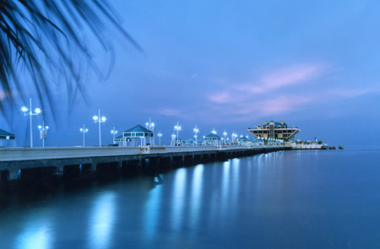
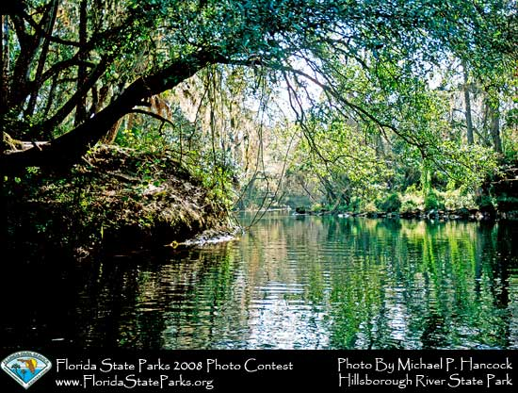
Bodies of water
Lakes, Oceans & Rivers
http://www.floridastateparks.org/photocontest/images/AllPhotos/February2008-3675-1509-130.jpg
http://www.preserveatlakethomas.com/images/Lake%20Thomas[1].JPG

Slide 9
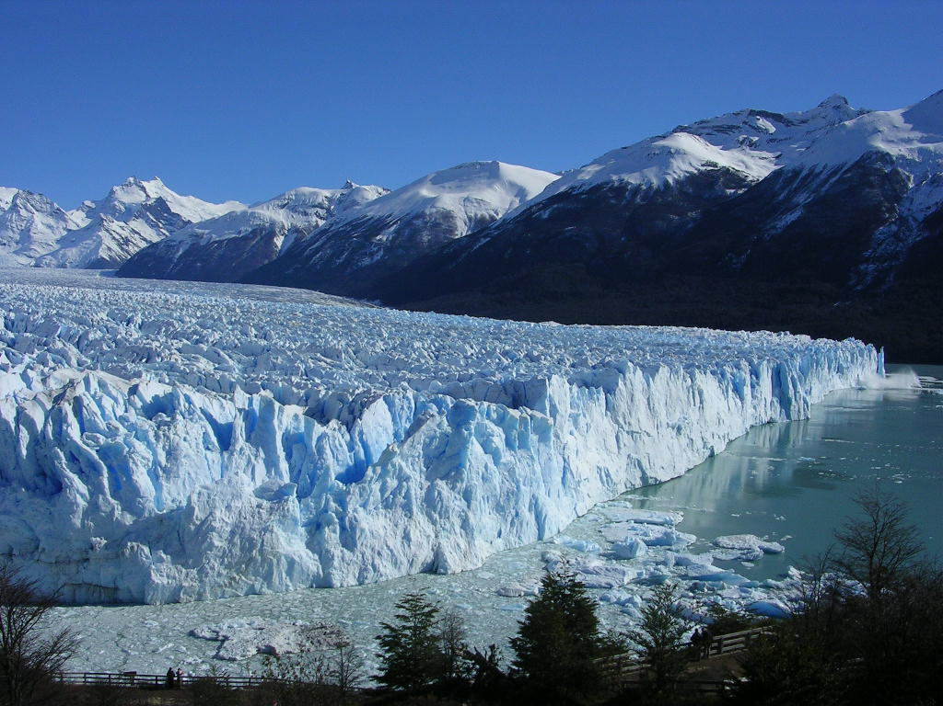
Mountains and Glaciers

Slide 10
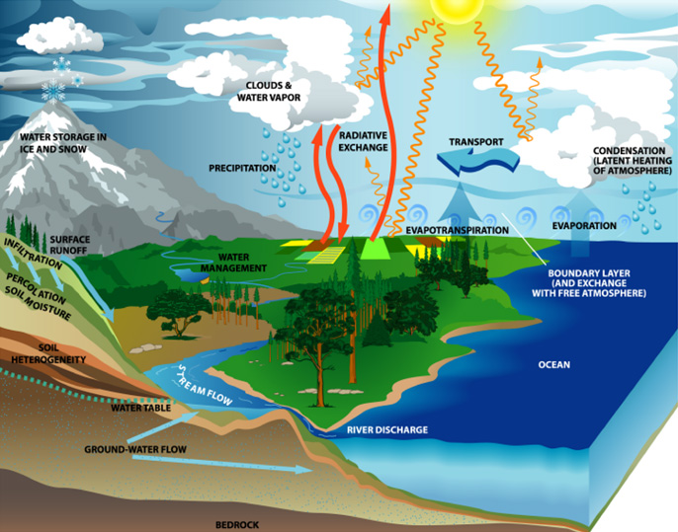
Water Cycle in a Nut Shell

