Slide 1
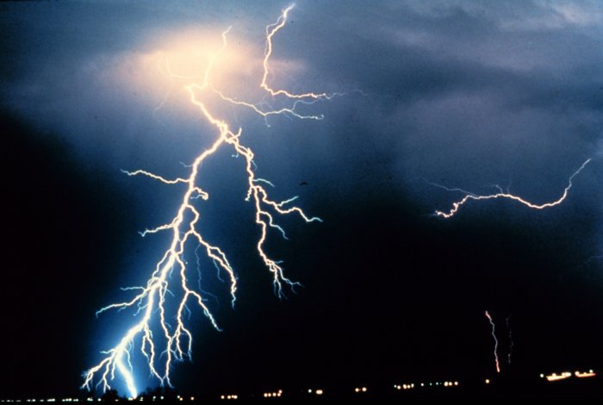
Thunder Storms
Mandek Richardson
STARS
University of South Florida

Slide 2
What is a Thunderstorm
Thunderstorm is a form of weather that contains lightning and thunder
Can have heavy rain, snow, hail or no precipitation at all

Slide 3
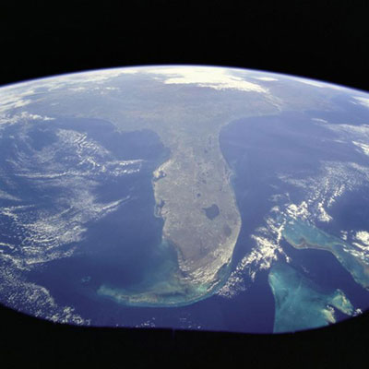
Thunderstorms
What state has the highest number of thunderstorms per year?
Answer: Florida
Florida has over 90 thunderstorm days per year on average

Slide 4
Thunderstorms
Why is Florida such a thunderstorm hotspot?
  The state is surrounded by water
  Wind blows from the ocean over land
  The ocean provides a lot of moisture
  Moist air rises over Florida’s warm land surface

Slide 5
What Causes Thunderstorms
2 things cause thunderstorms
  Unstable air
  Moisture

Slide 6
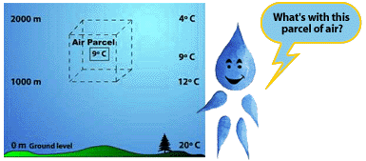
Unstable Air
Unstable air occurs when a part of the air is warmer than its environment and it continues to rise and rise

Slide 7
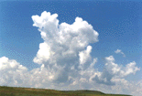
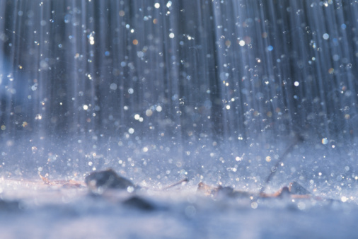
Moisture
Comes from a body of water and needed to form clouds and rain

Slide 8
How Thunderstorms Form
Heat and moisture near the earth’s surface is transported to the upper layers of the atmosphere
  Clouds, precipitation and winds are produced
Lets briefly go through the steps!

Slide 9
How Thunderstorms Form
Unstable air mass rises and expands
The air still warmer than its surroundings will keep rising
Water vapor present condenses and forms clouds
Warm air keeps rising and water vapor keeps condensing

Slide 10

Thunderstorm Life Cycle
3 basic stages
  Developing
  Mature
  Dissipating

Slide 11
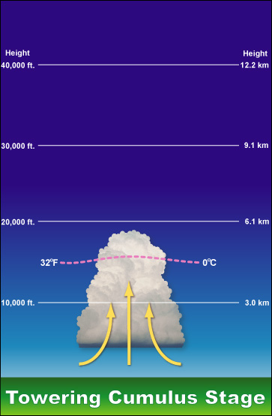
Developing Stage
Warm humid air rises
Warm air expands and becomes saturated
Towering cumulus cloud forms
Little or no rainfall

Slide 12
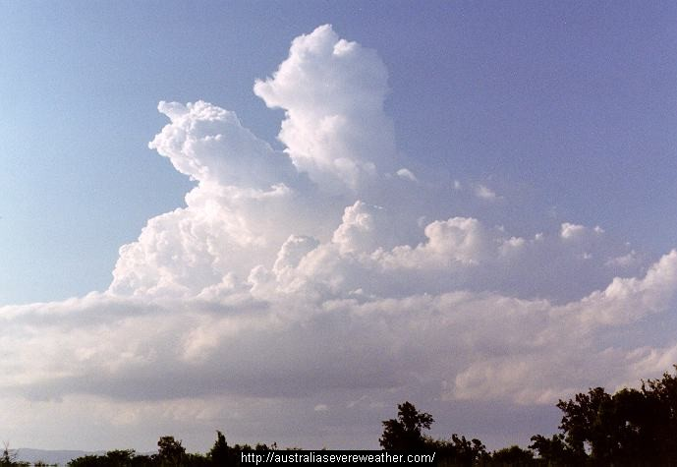
Developing Stage

Slide 13
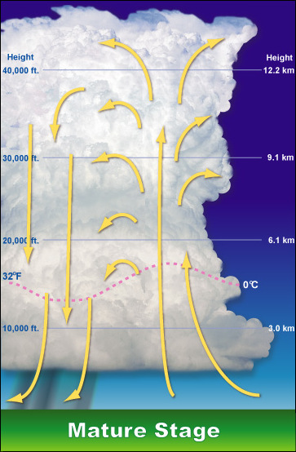
Mature Stage
Most likely time for sever weather (tornadoes, hailstorms)
Precipitation begins to fall

Slide 14
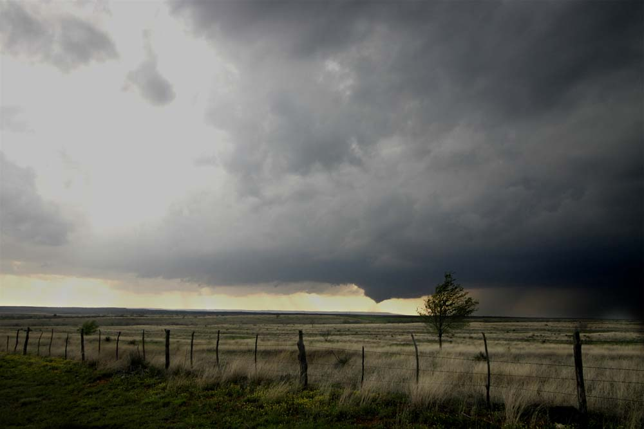
Mature Stage

Slide 15
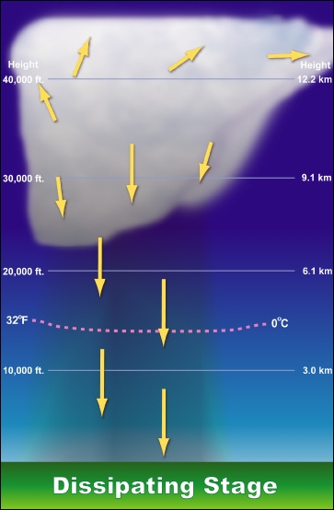
Dissipation Stage
Storm is starting to go away
Chances for severe weather have diminished
Lightning may still be a threat

Slide 16
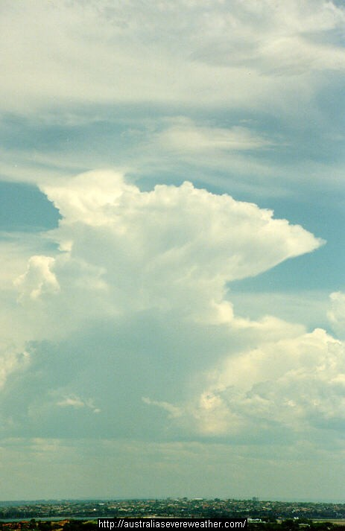
Dissipation Stage

Slide 17

Lightning
A bright flash of electricity produced by a thunderstorm
  an electric current
Within a cloud way up in the sky, many small bits of ice (frozen raindrops) bump into each other as they move around in the air transferring electrons
All of those collisions create an electric charge
After a while, the whole cloud fills up with electrical charges
Notes:
Javier

Slide 18
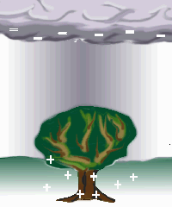
Causes of Lightning
Positive ions form at the top of the cloud and negative ions form at the bottom of the cloud
  Positive ions are lighter than negative ions
    Ion - an atom or molecule which has lost or gained one or more electrons
A positive charge builds up on the ground beneath the cloud since opposites attract
Notes:
Javier

Slide 19
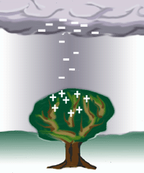
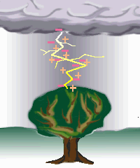
Causes of Lightning
The grounds electrical charge concentrates around anything that sticks up
  mountains, people, or single trees.
The charge coming up from these points eventually connects with a charge reaching down from the clouds and - zap - lightning strikes!
Notes:
Javier

Slide 20
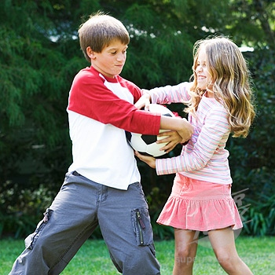
Boy vs. Girl Weather
Challenge

Slide 21
Question #1
What is weather?

Slide 22
Question #2
What type of cloud is this?

Slide 23
Question #3
Why are clouds white?

Slide 24
Question #4
What causes wind?

Slide 25
Question #5
Define the word climate

Slide 26
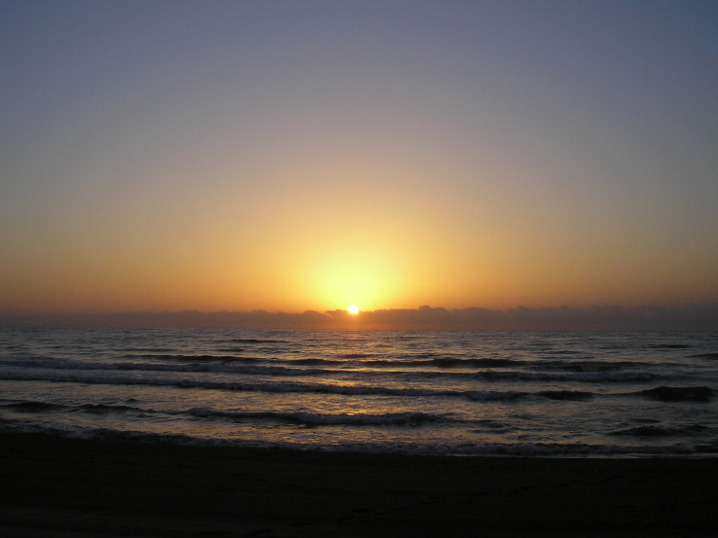
Question #6
The sun rises in the east or the west?

Slide 27
Question #7
What is condensation?

Slide 28
Question #8
What is the
winter solstice?

Slide 29
Question #9
What does a barometer
measure?

Slide 30
Question #10
What is evaporation?

Slide 31
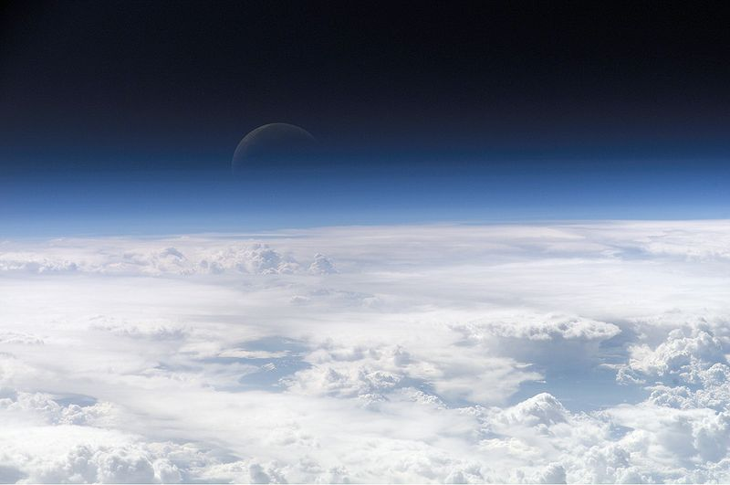
Question #11
What is the atmosphere?

Slide 32
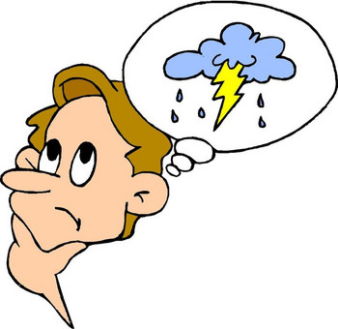
Question #12
What layer of the atmosphere does weather occur in?

Slide 33
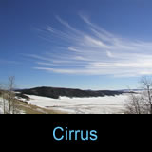
Question #13
What type of cloud is this?

Slide 34
Question #14
How do you measure precipitation?

Slide 35
Question #15
Define the word humidity?

Slide 36
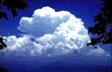
Question #16
What type of cloud is this?

Slide 37
Question #17
Name 5 ways to describe weather conditions.
  1.
  2.
  3.
  4.
  5.

