Slide 1
Electricity

Slide 2
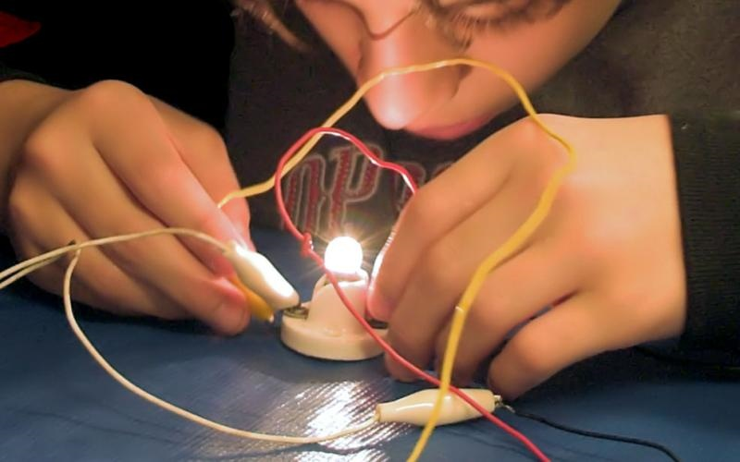

How Does Electricity Work?
What is electricity made of?

Slide 3
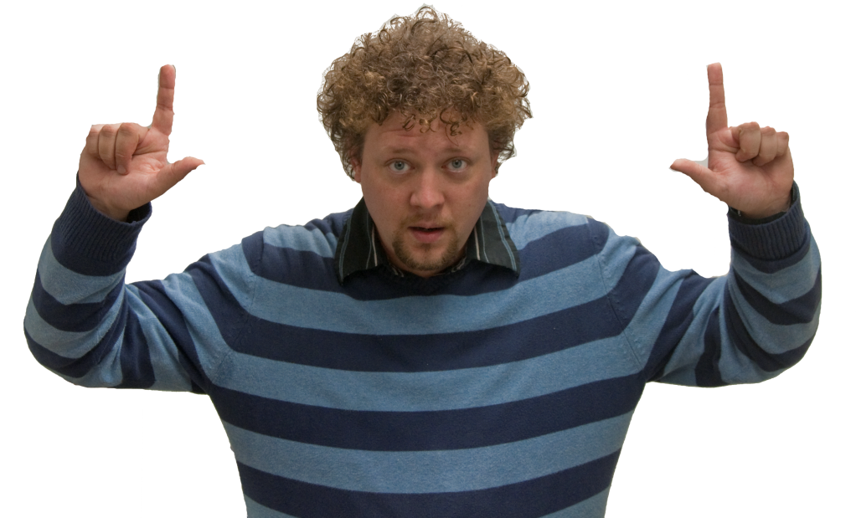
Introducing…. Electrons!
An electron is a very small particle
  Orbits around the atom (Like the earth around the sun)
Atom
e⁻
+
e⁻

Slide 4
Remember Magnets?
S
S
N
N
S
S
N
N
Opposites Attract!
S
S
N
N
S
S
N
N
Like Repels!

Slide 5
Magnets and Electricity are similiar
+
-
S
N
Positive Side
Negative Side

Slide 6
Electrons act like magnets
Positive attracts what?
  Negative!
But how do they get over there?
  They need something to travel on, like a metal wire!
+
e⁻
e⁻
e⁻
e⁻
e⁻
e⁻
-
e⁻
e⁻
Conduction!

Slide 7
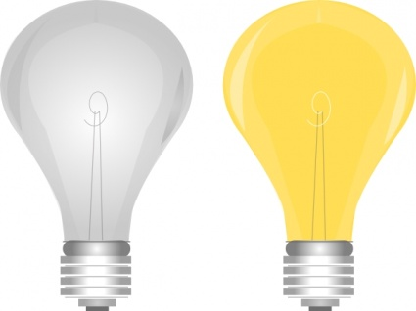
A Battery!
Potential (stored) Electrical Energy
What can we use a battery for?
Light Bulb!
9 Volt
Nerd-A-Cel

Slide 8
The moving electrons make it work!
+
e⁻
e⁻
e⁻
e⁻
e⁻
e⁻
e⁻
e⁻

Slide 9

Activity Time!

Slide 10
The moving electrons make it work!
e⁻

