Slide 1
Force and Motion: Part ii
Ryan Cates
University of South Florida
Big Idea 11: Energy Transfer and Transformation

Slide 2
Vocabulary Review
  What is a force?
  Why do weights differ on other planets?
  What is the difference between mass and weight?
  What are 4 other types of potential energy?
  Electricity is a flow of ______?

Slide 3
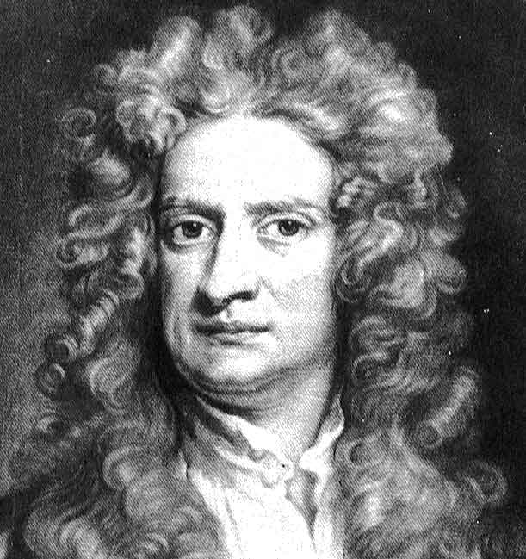
Newton’s Laws of Motion

Slide 4
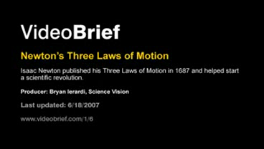
Newton’s Laws of Motion Video

Slide 5
Newton’s Second Law
An object that feels a force also feels and acceleration.

Slide 6
Force = mass x acceleration
Which object will have greater force if acceleration is the same?

Slide 7
Activity!
Weight race

Slide 8
Penny in a glass activity

Slide 9
References
"Forkin’ Cool « Innocent Bystanders." Innocent Bystanders. 27 Oct. 2009 <http://michaelscomments.wordpress.com/2008/02/28/forkin-cool/>.
"Fork Trick (© FMS Computer Training)." FMS Computer Training (© FMS Computer Training). 27 Oct. 2009 <http://www.barrett.net/forktrick.html>.
"YouTube - Insane Chair Balancing." YouTube - Broadcast Yourself.. 27 Oct. 2009 <http://www.youtube.com/watch?v=6aB8I63JFB8>.
akkoKaisui. "YouTube - Newton's Laws of Motion illustrated with 3D animations and motion graphics." YouTube - Broadcast Yourself.. 28 Oct. 2009 <http://www.youtube.com/watch?v=iH48Lc7wq0U>.

