Slide 1
Force and Motion: Part iiI
Ryan Cates
University of South Florida
Big Idea 11: Energy and Transfer and Transformation

Slide 2
Vocabulary Review
  What is the Newton’s first law of motion (law of inertia)?
  What is the difference between mass and weight?
  What are 5 types of potential energy?
  A block weighing 100 pounds will have how many times more inertia than a block weighing 50 pounds?
  What were the forces that kept the penny on the paper in the penny in the cup experiment?

Slide 3

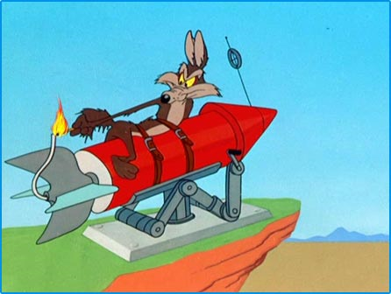
Newton’s Second Law
An object that feels a force also feels and acceleration.

Slide 4
Force = mass x acceleration
Which object will have greater force if acceleration is the same?

Slide 5
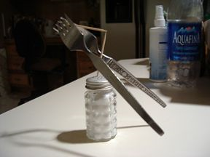
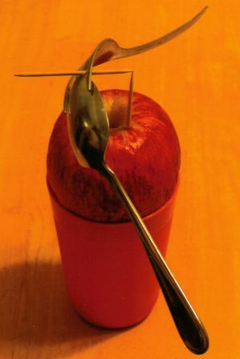
Balancing toothpicks

Slide 6
Insane chair balancing

Slide 7
References
"Forkin’ Cool « Innocent Bystanders." Innocent Bystanders. 27 Oct. 2009 <http://michaelscomments.wordpress.com/2008/02/28/forkin-cool/>.
"Fork Trick (© FMS Computer Training)." FMS Computer Training (© FMS Computer Training). 27 Oct. 2009 <http://www.barrett.net/forktrick.html>.
"YouTube - Insane Chair Balancing." YouTube - Broadcast Yourself.. 27 Oct. 2009 <http://www.youtube.com/watch?v=6aB8I63JFB8>.
akkoKaisui. "YouTube - Newton's Laws of Motion illustrated with 3D animations and motion graphics." YouTube - Broadcast Yourself.. 28 Oct. 2009 <http://www.youtube.com/watch?v=iH48Lc7wq0U>. http://www.ucpl.lib.mo.us/childrens/Clips/race.jpg
http://www.youtube.com/watch?v=iH48Lc7wq0U
http://www.animationartgallery.com/images/CJG/CJGSPTR.gif
http://www.teambenya.com/.a/6a00e54ef03e8988330105362f67cf970b-800wi

