Slide 1
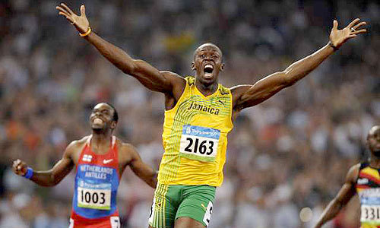
Forces and Motion
Mandek Richardson
University of South Florida
STARS Program

Slide 2
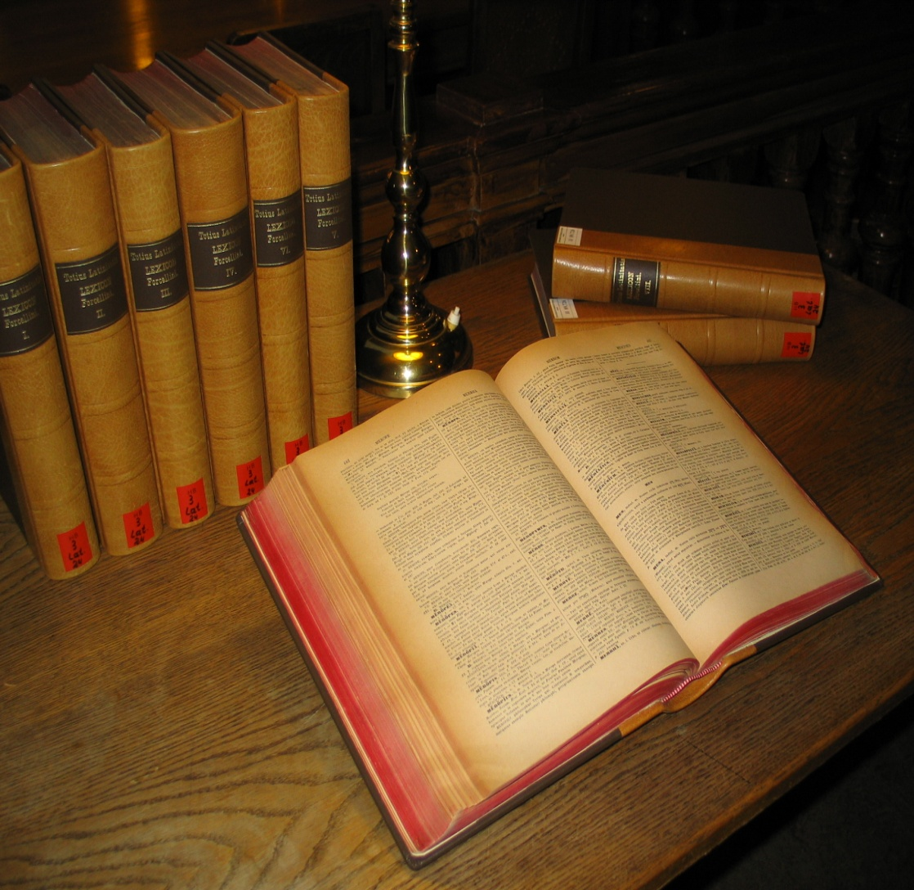
Vocabulary
Friction
Gravity
Position
Speed
Velocity
Acceleration
Momentum

Slide 3
Types of Forces?

Slide 4
Friction
Friction
  force that opposes motion between 2 surfaces
  depends on the:
    types of surfaces
    force between the surfaces

Slide 5
Friction
Friction is greater...
  between rough surfaces
  when there’s a greater force between the surfaces
  (e.g. more weight)

Slide 6
Gravity
Gravity
  force of attraction between any two objects in the universe
  increases as...
    mass increases
    distance decreases

Slide 7
Gravity
Who experiences more gravity - the astronaut or the politician?
Which exerts more gravity -
the Earth or the moon?
more mass
less distance

Slide 8
Gravity
Weight
  the force of gravity on an object
W = mg
W: weight (N)
m: mass (kg)
g: acceleration due to gravity (m/s²)
MASS
always the same
(kg)
WEIGHT
depends on gravity
(N)

Slide 9
Gravity
Would you weigh more on Earth or Jupiter?
  Jupiter because...
    greater mass
    greater gravity
    greater weight

Slide 10

Position
The location of an object in space and it always depends on a frame of reference
What words describe position?
East
West
Above
Below

Slide 11
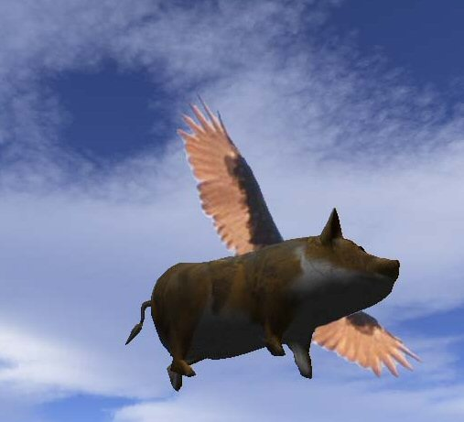
Speed and Velocity

Slide 12
Speed and Velocity
Speed is the distance an object travels in a certain amount of time
  Tells you how quickly or slowly something is moving

Slide 13
Speed and Velocity
Velocity is the measure of an objects speed in a certain direction
  Must know a direction something is moving to know its velocity
5 miles/hr, east
5 miles/hr, west
5 miles/hr, north

Slide 14
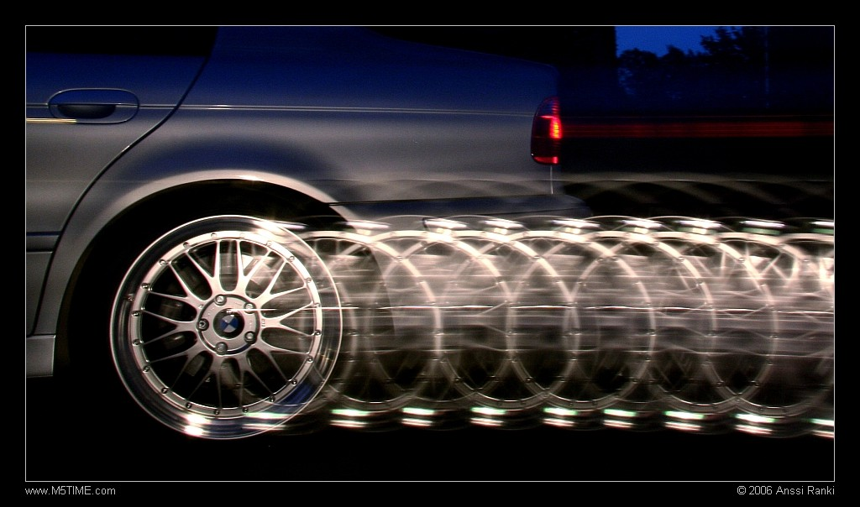
Acceleration
How fast an object’s velocity changes over time
An object accelerates when it slows down or speeds up

Slide 15
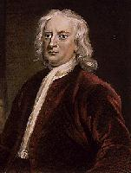
Newton’s First Law
Newton’s First Law of Motion
  An object at rest will remain at rest and an object in motion will continue moving at a constant velocity unless acted upon by a net force.

Slide 16
Newton’s Second Law
Newton’s Second Law of Motion
  The acceleration of an object depends on the object’s mass and the force applied to it
F = ma

Slide 17
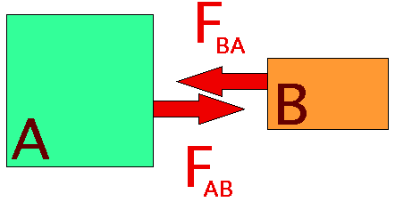
Newton’s Third Law
Newton’s Third Law of Motion
  When one object exerts a force on a second object, the second object exerts an equal but opposite force on the first.

