Slide 1

Changes in Matter
Mandek Richardson
University of South Florida
STARS Program

Slide 2
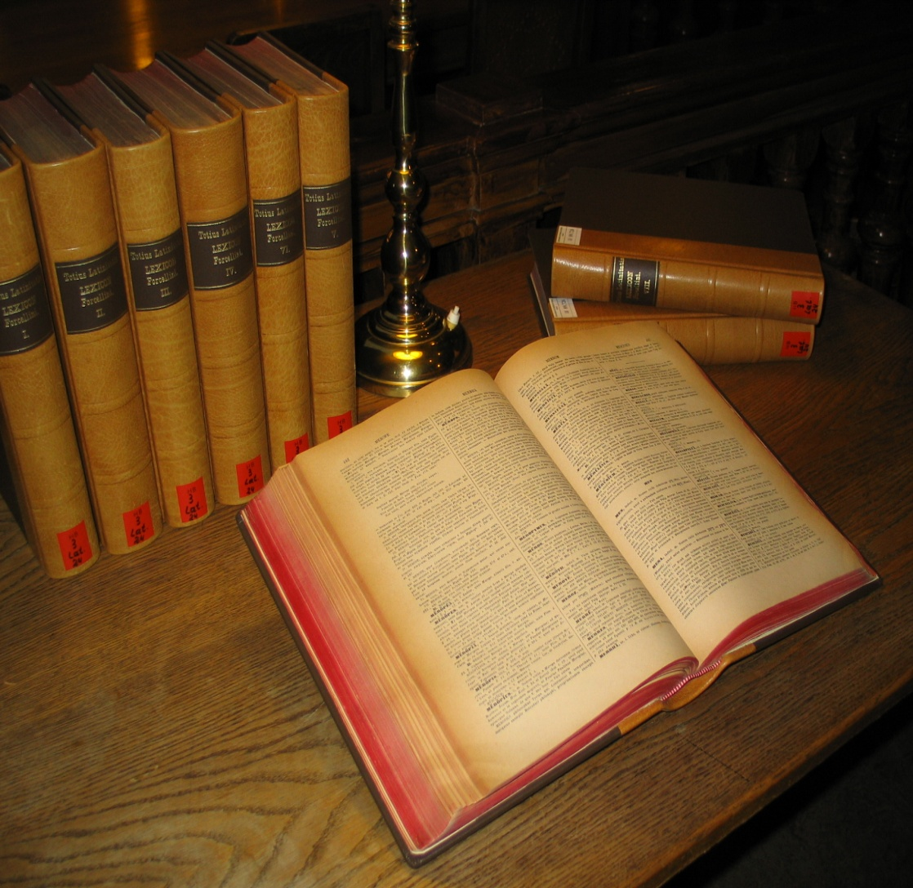
Vocabulary
Condensation
Evaporation
Sublimation
Deposition
Freezing
Melting
Physical change
Chemical change

Slide 3
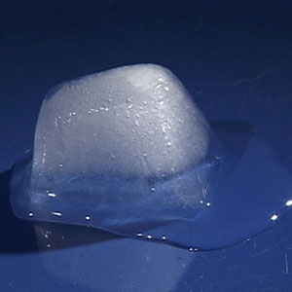
Phase Changes
A phase change is a reversible process in which a substance changes from one state of matter to another

Slide 4
Sublimation and Deposition

Slide 5
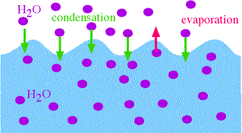
Evaporation and Condensation
Evaporation = Liquid ➔ Vapor
Condensation = Vapor ➔ Liquid

Slide 6
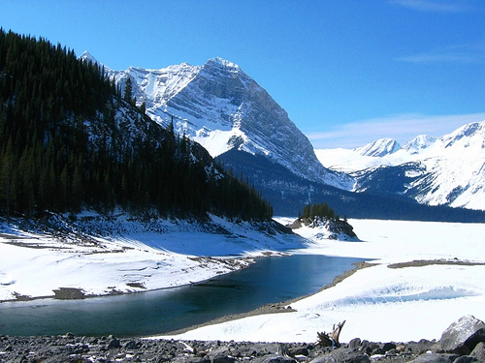
Freezing and Melting
Freezing = Liquid ➔ Solid
Melting = Solid ➔ Liquid

