Slide 1
Density
Ms. Dayna Lee Martínez
STARS USF
Maniscalco Elementary

Slide 2
Physical Properties
Physical properties can be observed or measured without changing the composition of matter. Physical properties are used to observe and describe matter.
Some physical properties include:
  Appearance, size , color, texture, odor, melting point, boiling point, mass, weight, volume, density, etc...

Slide 3
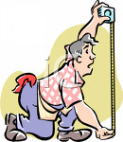
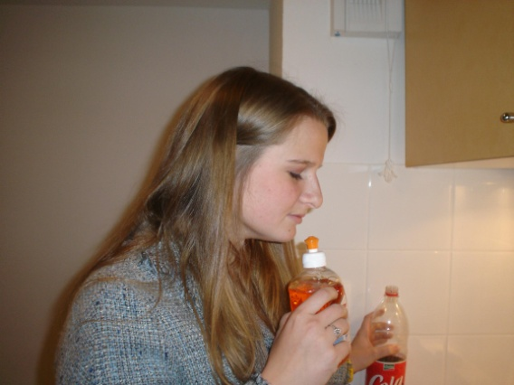
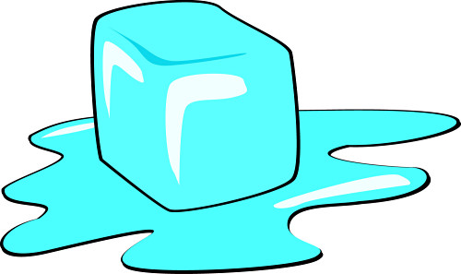
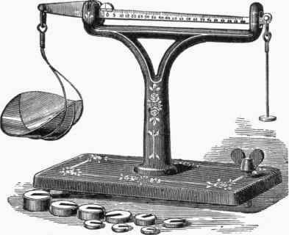
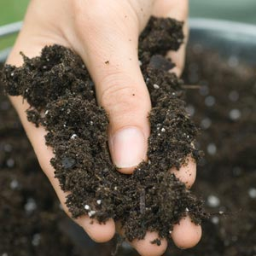
Some examples…
Remember, physical properties are used to observe and describe matter. It doesn’t change the composition of matter.

Slide 4
What is matter?
Matter is everything around you!
Matter is anything made of atoms and molecules. Matter is anything that has a mass.
Matter can be found in different states.

Slide 5
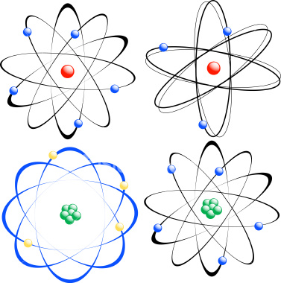
Before we go to the states of matter…
What are atoms?
Atoms are the basic building blocks of matter that make up everyday objects
They are made out of protons, neutrons and electrons
The protons and neutrons are found in the nucleus
The electrons go around the nucleus
When you stick two or more atoms together you get a molecule (i.e. H2O)

Slide 6
Before we go to the states of matter…
What is mass?
  Amount of matter in a substance.
Is mass and weight the same? What do you think?
  No. Weight is how heavy something is.

Slide 7
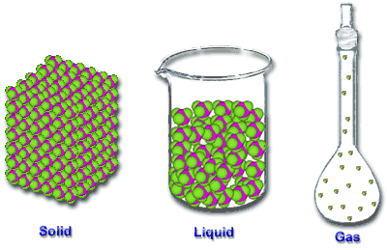
States of matter

Slide 8

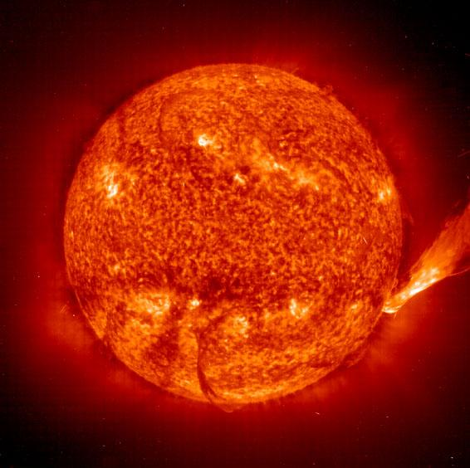
There are more states of matter!
Plasma
  Is a gas, in which a certain proportion of electrons are free rather than being bound to an atom or molecule.

Slide 9
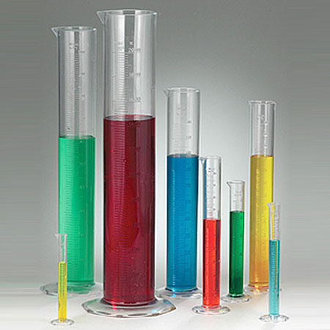
What is volume?
Measures the space that matter occupies

Slide 10
What is density?
Mass is the measure of the "stuff" of matter
Volume measures the space that matter occupies
Density measures how much "stuff" is in how much "space" or how tightly compacted matter is
Density = mass / volume

