Slide 1
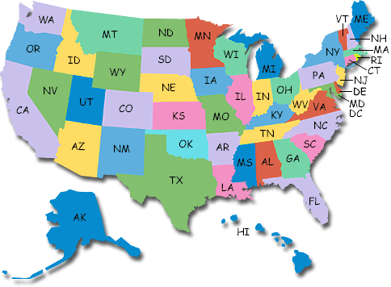
States of Matter
Mandek Richardson
University of South Florida
STARS Program

Slide 2
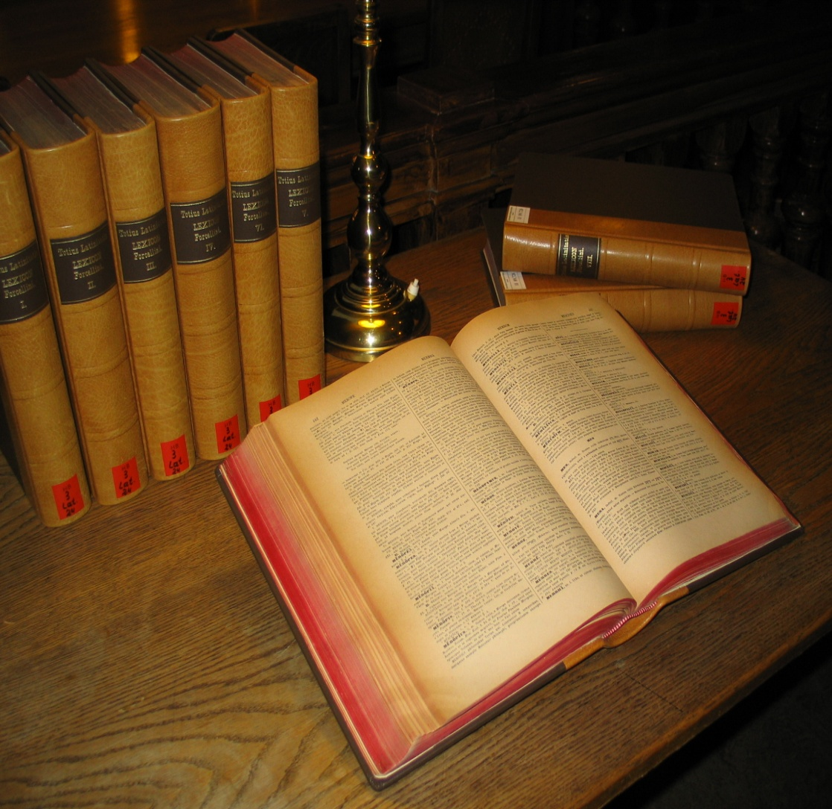
Vocabulary
Gas
Liquid
Solid
Condensation
Evaporation
Sublimation
Deposition
Freezing
Melting

Slide 3

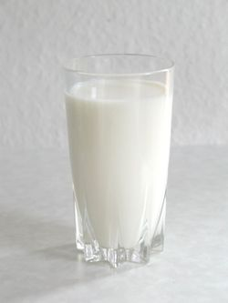
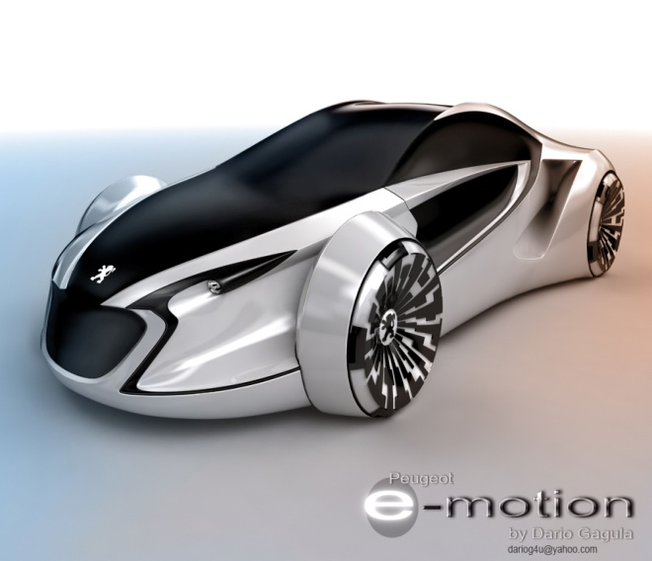
Review
What is Matter?
Anything that takes up space and has mass is matter.

Slide 4
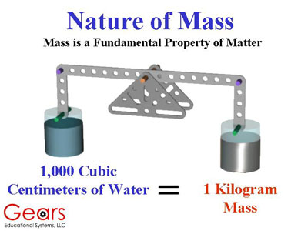
Review
What is Mass?
Mass is the amount of matter that something contains

Slide 5

Review
What is volume?
Volume is the amount of space that an object takes up

Slide 6
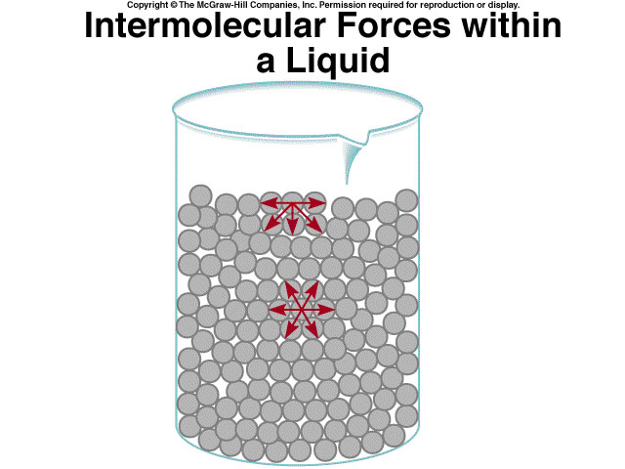
Review
What is density?
Density is how crowded molecules in an object are

Slide 7
There are How Many States
of Matter?
4

Slide 8
The Four States of Matter
Gas
Liquid
Solid
Plasma

Slide 9
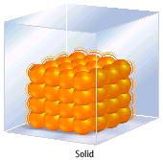
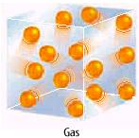
Properties of Matter
All Matter is composed of small particles (atoms, molecules and Ions)
The particles are in constant random motion

Slide 10


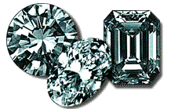
Solids
Particles in solids are tightly packed
Solids have a definite shape and volume
Particles in solids do not move around much
  Vibrate in place

Slide 11



Liquids
Particles in liquids are tightly packed but not as much as solids
Particles are free to slide past each other
Liquids have a definite volume but not a definite shape

Slide 12

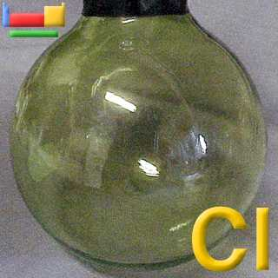
Gases
Particles in a gas are far apart
  Move very fast
Gases have no definite shape or volume

Slide 13
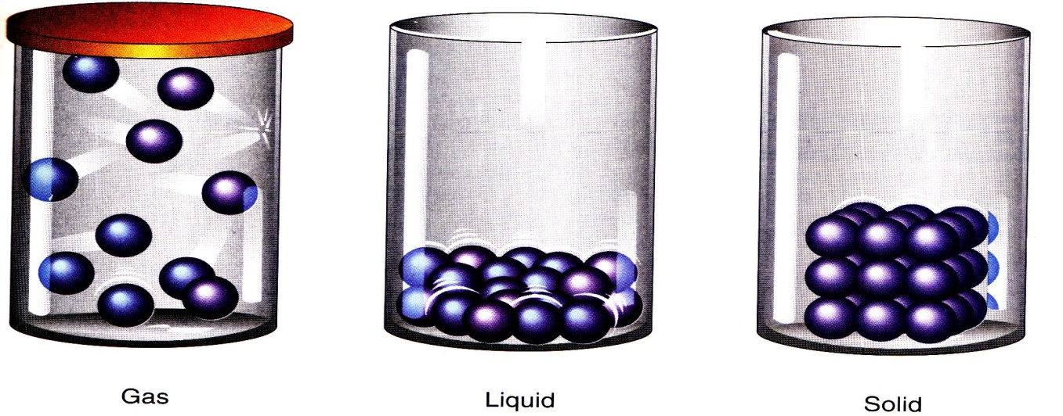
Review
State of Matter | Particle Movement | Volume | Shape
Solid | Vibrate | definite | definite
Liquid | Sliding | definite | indefinite
Gas | Very fast | indefinite | indefinite

Slide 14
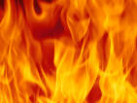
What happens if you raise the temperature of a gas to super-high levels… between
1000°C and 1,000,000,000°C ?
Will everything just be a gas?

Slide 15
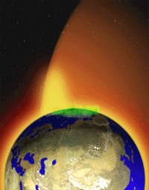
NO!
The gas is ionized
  contains moving electrons and ions.
Ionization occurs as result of adding energy
  light, thermal or electrical
Distinctive Properties
Fourth State of Matter
PLASMA

Slide 16
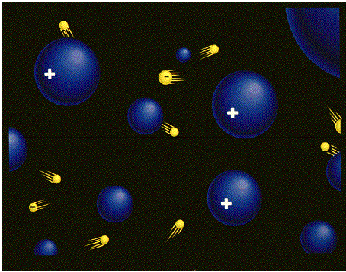
Plasma
A plasma is an ionized gas
Plasmas are good conductors of electricity and are affected by magnetic fields
Plasmas have an indefinite shape and an indefinite volume

Slide 17
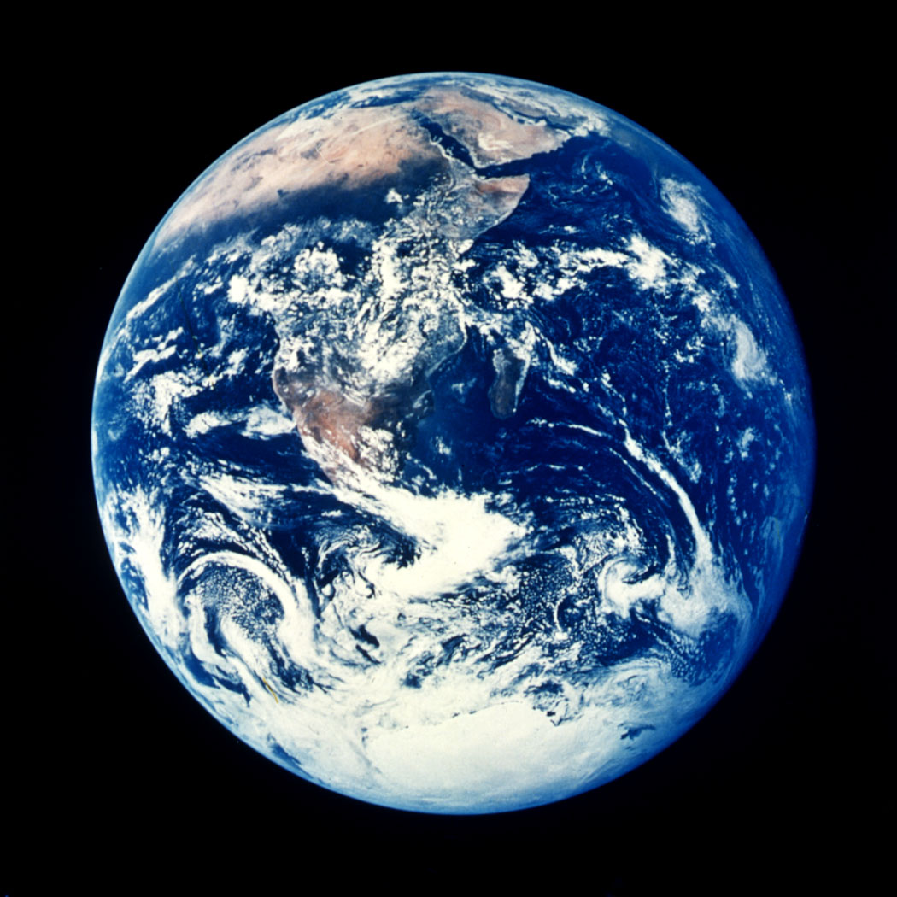
Question
Which state of matter is most abundant on the earth?
Liquids

Slide 18
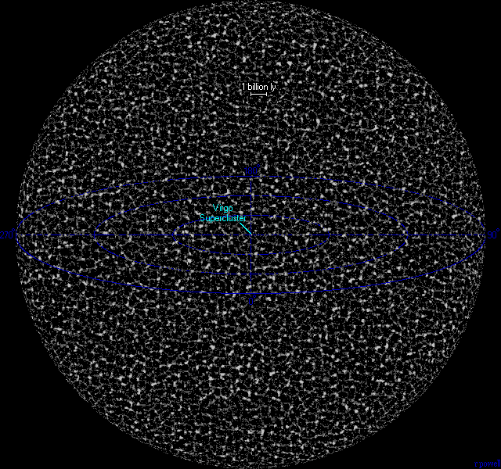
Question
Which state of matter is most abundant in the universe?
Plasma

Slide 19
Review Questions
How many states of matter are there?
Define matter?
Solids have an indefinite shape
Liquids take the shape of their container
Particles in a gas move very slow

