Slide 1
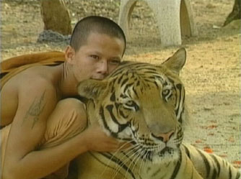
Interactions in Nature
Mandek Richardson
STARS Program
University of South Florida

Slide 2

Vocabulary/Key Words
Population
Community
Competition
Adaptation
Symbiosis
Predator
Prey

Slide 3
Ecosystems
Ecosystems vary in size. They can be as small as a puddle or as large as the earth. Any group of living and non living things interacting with each other can be considered as an ecosystem.

Slide 4
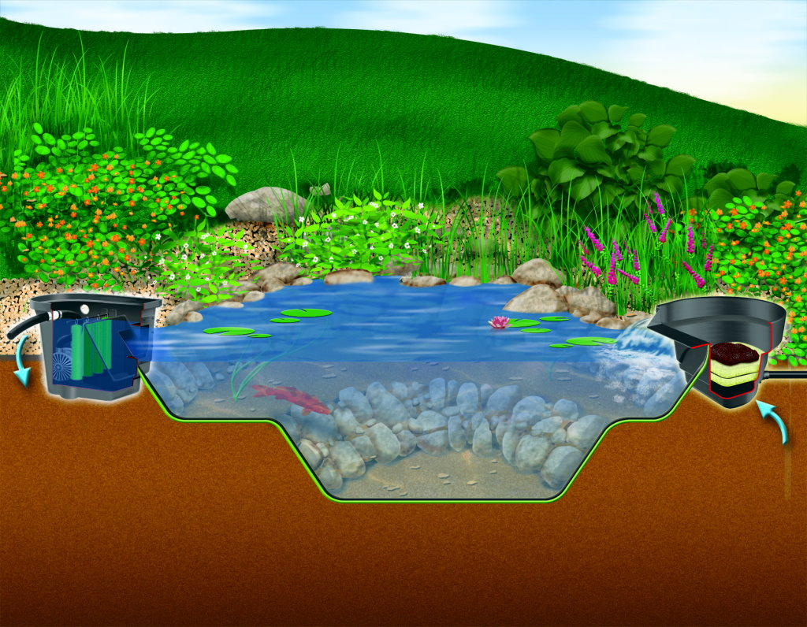
What would be included in this ecosystem?

Slide 5
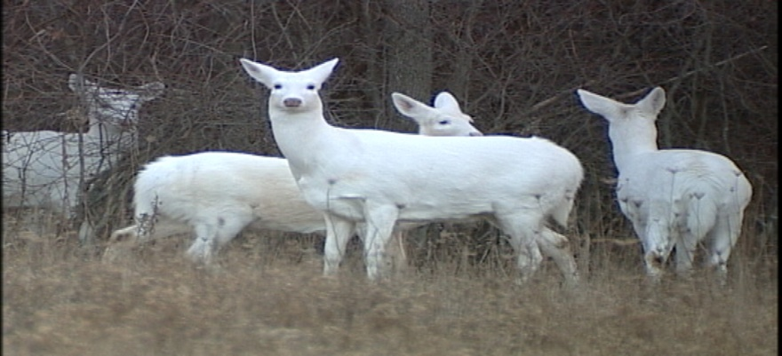
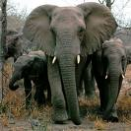
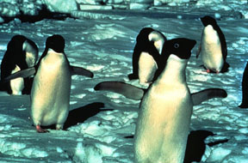
Population
In an ecosystem all the organisms of one kind would be a population.

Slide 6
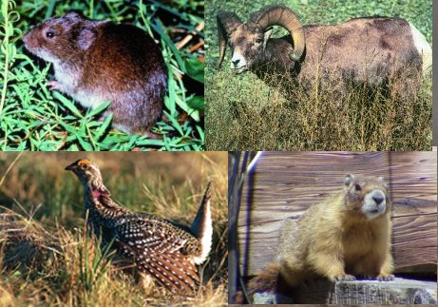
Community
Populations living and interacting with each other form a community.

Slide 7
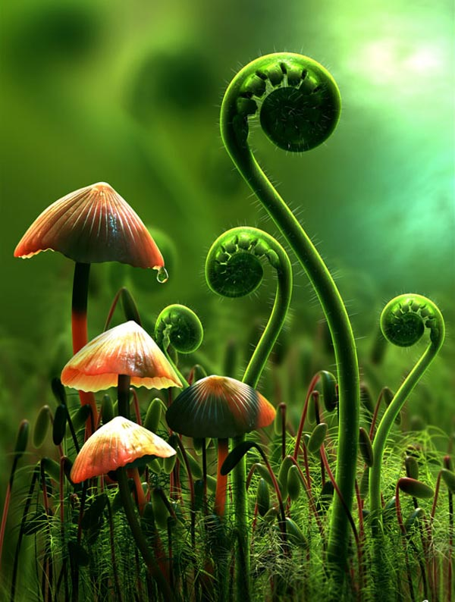
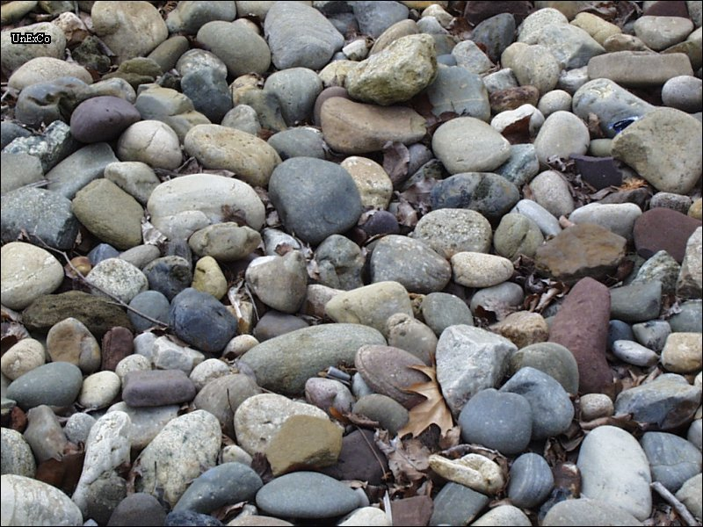

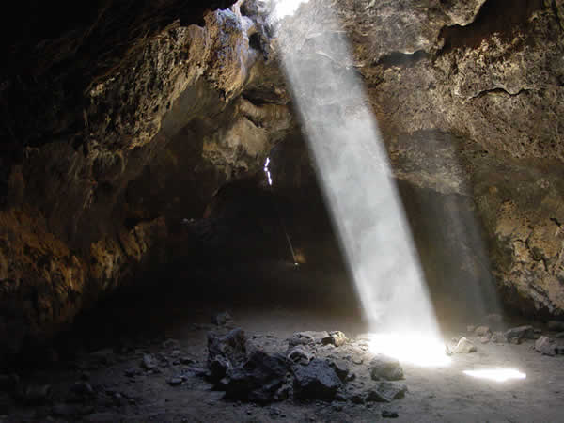
Ecosystem
What other things can you find in an ecosystem?

Slide 8
Survival
What does each population need to survive?
  Food
  Water
  Shelter
  Space

Slide 9
Competition
Competition will result when there is a shortage or challenge among populations to meet their basic needs
  Competition for the same food
  Competition for space or shelter
  Competition for mates

Slide 10
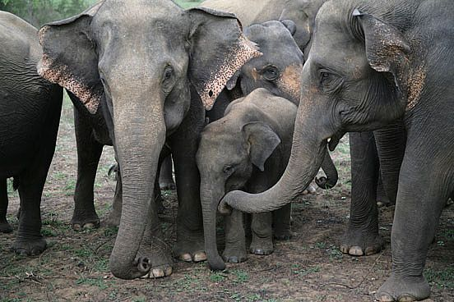
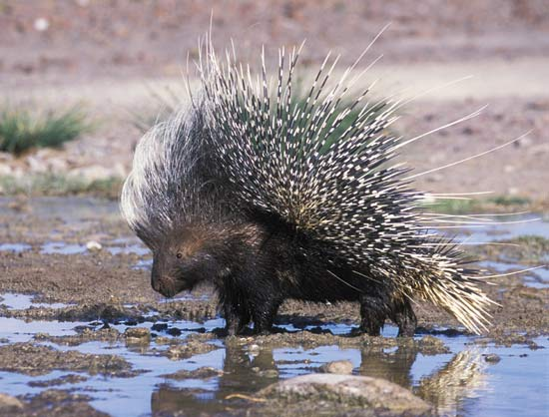
Adaptation
To survive or compete in an ecosystem animals must adapt
  Adaptations can be…
    Behavioral
    Structural

Slide 11
Symbiosis
Do populations always compete with each other?
A relationship between different organisms is called symbiosis
  Both organisms benefit (mutualism)
  Only one organism benefits (commensalism)
  One benefits and the other is harmed (parasitism)

Slide 12
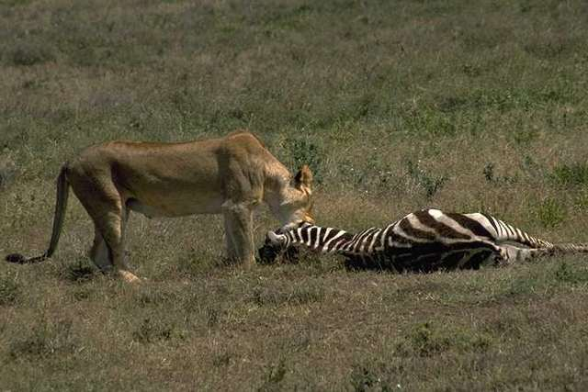
Predator and Prey
Predators eat other animals
Animals that are eaten are prey

Slide 13
Predator and Prey
Do prey need predators?
What would happen if a prey’s food supply increases?
What happens if the number of predators decreases?

